Slide 1
What Is Your Body Telling You? How To Listen and Be a Better Lawyer
Erika Beetcher, CNP, MS, DNP and Beatriz Hernandez, Esq.

Slide 2
Objectives of Talk
Discuss tests and labs we should be seeking for our overall well-being from our primary care providers and why.
Understand how to interpret and act on measurements of health for us and our loved ones.
Empower listeners to know when to screen for certain conditions and from whom to seek care.
*Disclaimer: This talk is intended for informational purposes only and does not substitute professional medical management by attendees’ own healthcare professional. Opinions stated are my own and do not necessarily represent that of my employer’s.
Guidelines are just guidelines and may differ in recommendations. Always individualize your own medical needs.

Slide 3
Preventive health screening Recommendations for non-pregnant adults only of average risk unless specified. Terms male or men apply to assigned male at birth (AMAB); Terms female or women apply to assigned female at birth (AFAB).
Breast cancer
Cervical cancer
Colorectal cancer
Prostate cancer
Skin cancer
What to do?

Slide 4
Higher risk for cancer?
Personal or family history; BRCA1/2 gene mutation.
Known correlations
Vaccines
What to do?

Slide 5
* Infectious Diseases * STI/STD risks * LGBTAI+ community * TB
Chlamydia & Gonorrhea
Syphilis
Hepatitis (B& C) & HIV
What to do?

Slide 6
* Depression * Anxiety * Mental health * Abuse
* Fall Prevention
* Osteoporosis
* What to do?

Slide 7
Substance Use
Lung cancer screening
Abdominal aortic aneurysm screening
Alcohol use
Recreational drug use
What to do?

Slide 8
Heart health
Prediabetes & Diabetes screening
Hypertension (high blood pressure)
Lipids/cholesterol
Weight & activity
What to do?

Slide 9
Symptoms not to ignore
Unexplained weight loss
Persistent or high fever
Shortness of breath
Unexplained bowel habit changes
Confusion or personality changes
Early satiety
Vision changes
Erika’s additions; evaluation recs

Slide 10
Holistic Health Practices * Mind * Body * Spirit * What to do?

Slide 11
Personal practice of a daily full body check Led by Beatriz Hernandez
What is a body scan?
Benefits of a body scan.
An example of this practice.
Contributing factors at time of scan that may manifest as physical symptoms?
No guilt - just listening to & learning from your findings.

Slide 12
References
American Cancer Society. (2021, December 16). Should i take medicine to lower my breast cancer risk? American cancer society. Retrieved September 30, 2022, from https://www.cancer.org/cancer/breast-cancer/risk-and-prevention/deciding-whether-to-use-medicine-to-reduce-breast-cancer-risk.html
Centers for Disease Control and Prevention. (2022, August 5). Adult immunization schedule by vaccine and age group. Centers for disease control and prevention. Retrieved October 1, 2022, from https://www.cdc.gov/vaccines/schedules/hcp/imz/adult.html
Mayo Clinic. (2022, February 26). Calcium and calcium supplements: Achieving the right balance. Retrieved October 1, 2022, from https://www.mayoclinic.org/healthy-lifestyle/nutrition-and-healthy-eating/in-depth/calcium-supplements/art-20047097#:~:text=Dairy%20products%2C%20such%20as%20cheese,fruit%20juices%2C%20and%20milk%20substitutes
Mayo Clinic. (2022, April 26). 7 signs and symptoms not to ignore. Retrieved October 3, 2022, from https://www.mayoclinic.org/healthy-lifestyle/adult-health/in-depth/symptoms-not-to-ignore/art-20045276
National alliance on mental illness. (n.d.). Nami helpline. Nami. Retrieved October 3, 2022, from https://nami.org/help
Unites States Preventive Services Task Force. (n.d.). U.S. preventive services task force a and b recommendations. uspreventiveservicestaskforce.org. Retrieved September 3, 2022, from https://www.uspreventiveservicestaskforce.org/uspstf/recommendation-topics/uspstf-a-and-b-recommendations

Slide 13
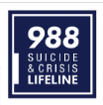
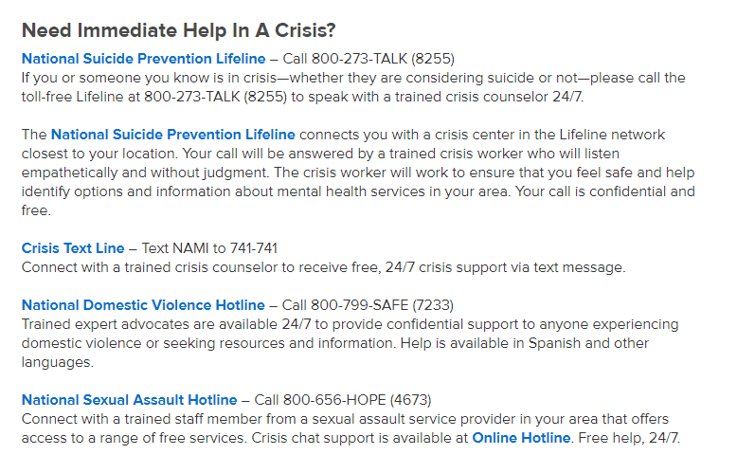
Emergencies – call 911 (in U.S.). NAMI Crisis resources

Slide 14
THANK YOU!!! Questions?

