Slide 1
Reclaim Your Time

Slide 2
Decision Fatigue + Disorganization = Chaos
Email inbox as to-do list
Electronic task lists
Notifications
Physical to-Do Lists
Post-Its
Social media inboxes (LinkedIn, Facebook, Instagram, Messenger)
Phone calls, voicemail, WhatsApp…
Stacks of documents

Slide 4
Burnout
Emotional, physical, and mental exhaustion caused by excessive and prolonged stress
Signs and symptoms
Sense of failure and self-doubt
Loss of motivation/detachment
Feeling tired, drained and overwhelmed
Negative outlook
Withdrawing from responsibilities and others
Procrastination
Buffering negative emotions with food, drugs, alcohol, doom scrolling, etc.

Slide 5
The Burnout SOLUTION
Manage your mind (release indulgent emotions like blame, resentment, self-pity)
Discover your TIME PRIORITIES (your priorities on how you spend your time)
Establish strong, healthy boundaries - letting go of HUMAN GIVER SYNDROME
Understanding that SELF-MAINTENANCE is not optional; it’s necessary
Recognizing DECISION FATIGUE
Time manages itself. We have to manage our mind around time
There is always enough time
Time is an illusion. Time is what YOU decide it is

Slide 6
How do these thoughts feel?
Not enough time in the day
It’s crunch time
Time is running out
“Time and tide wait for no man.” – Geoffrey Chaucer
Time is money
It’s wasted time
I have a tight deadline

Slide 7
How do these thoughts feel
Time is on my side
There is plenty of time
Good things take time
“The two most powerful warriors are patience and time” — Tolstoy
“The most precious resource we all have is time.” — Steve Jobs

Slide 8
You have “enough” time; I promise
Time is the great equalizer. We all have the same amount
“I don’t have enough time” does not generate motivation
Is the way you spend your time in line with your priorities?
Pinpoint inefficiencies like perfectionism, distractions, and interruptions
Set Boundaries, not blame
Set clear expectations
Develop integrity with yourself
Understand Parkinson’s Law - work expands to fill the time allotted. Put simply, the amount of work required adjusts to the time available for its completion.

Slide 9
RECLAIM YOUR TIME. No BS. No Drama
Uses the Prefrontal Cortex to make decisions by PLANNING AHEAD
You will HONOR your COMMITMENTS to yourself
Live your life deliberately
Plan your time consciously
Follow through with what you say you are going to do

Slide 10
Concepts
Constraint - Focus on one thing at a time (no such thing as multitasking)
Planning - Giving this the utmost seriousness and thoughtfulness
Empowerment - Understanding the difference between “I want to” and “I have to”

Slide 11
The Process
Start with one distraction-free hour before your work week begins (Sunday or Monday morning.
Seriously, TURN OFF all distractions
Identify your “inboxes,” i.e. email, texts, calls, documents, to-do list
On a blank sheet of paper write down every thing you currently have to do.
When you think you have it all, ask yourself “what else”
Determine what are the priorities for this week, what can be filed for later, long-term action items
Evaluate what you want to do

Slide 12
Put *ALL* action items on the calendar
Add your free-time and personal priorities FIRST (profit first and free-time first)
Add hearings, meetings, phone calls, appointments, email review periods
Add Focus Time
Two-hour, distraction-free block of time (further broken down by steps)
Creative endeavors (research, writing, creating, study)
No interruptions, no distractions, no notifications
You think you don’t have time for this, but you do
Add remaining time such as overflow time and space for unanticipated tasks

Slide 13
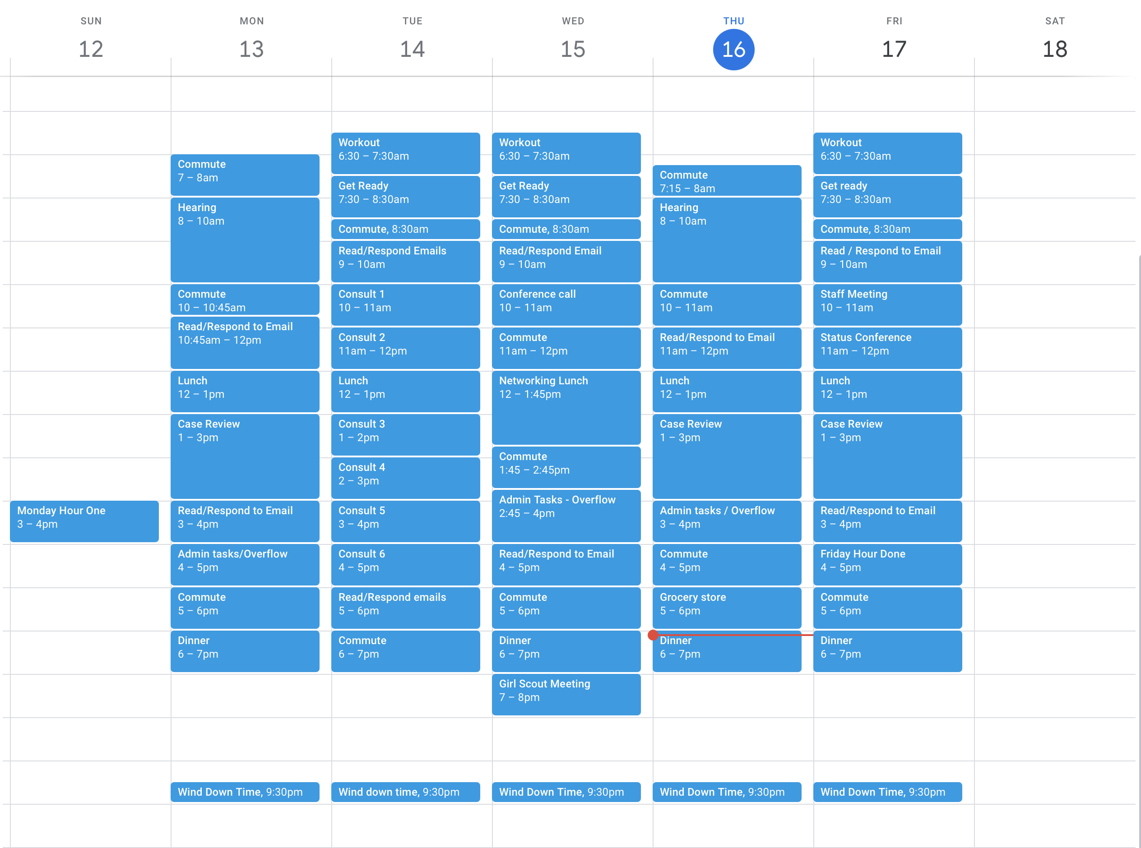

Slide 14
After Your Week Is Planned
File all items that require no action into “waiting” or archive in email
Establish a process for open items that go beyond the week (paper or electronic)
Discuss your system with support staff, co-workers, etc. on an as-needed basis
Tear up your TO DO DOWNLOAD so you can START FRESH next week
Now, your mind is uncluttered, unburdened, and you can start to work without expending the mental energy of wondering if you should be doing something else

Slide 15
Friday Review
Last hour of the work week
Celebrate three accomplishments from the week
Evaluate what didn’t work and anticipate obstacles to incorporate into next week
Identify open projects
Utilize a system to collect tasks for the week ahead (Asana, Monday, notes, paper…whatever works for you).

Slide 16
Tips
Do not take unscheduled phone calls
Set specific times to read and respond to email
Add a disclaimer to your email (I respond to emails received within 1 to 2 business days)
Establish contingency plans
Anticipate emergencies
Be realistic about what is an emergency
Delegate
Completion creates momentum
Parkinson’s Law - work expands to fill the time allotted. Put simply, the amount of work required adjusts to the time available for its completion.
Stop TRYING. Just do it.

Slide 17
Some Thoughts
This will be uncomfortable
You can do hard things
Discomfort is the currency of our dreams
Resistance equals persistence
You don’t need permission and you don’t need doubt
Acknowledge the truth about where you are. You can’t get to where you are going if you don’t know where you are. Don’t be afraid to look

