Slide 1
Health in Practice: Preventive Screening & Holistic Wellness To Become A Healthier Lawyer
Erika Beetcher, APRN, CNP, MS, DNP
Laura F. Kelley, Esq.
Notes:
Introductions –interest/experience in preventive medicine or wellness areas of interest : Erika, Laura

Slide 2
Objectives
Familiarize listeners with preventive health recommendations & wellness screenings
Discuss holistic health as applicable to life & work performance
Strategize for positive change via setting of wellness goals
Collaborate as presenters to share suggestions on nutrition, sleep, & exercise
Sources of info; disclaimer statement
Notes:
--Objectives of the talk.
--My disclaimer – I work for Mayo Clinic and much of the information I will share today is from their expert guidelines and my experiences there but today I am not representing my employer. The preventive health screening guidelines primarily combine Ask Mayo Expert, USPSTF, and CDC guidelines. I have no financial disclosures other than the speaking fee for this talk.
--My hope is that by providing information on how to keep you healthy and screen for conditions early, we can keep you out there in the world doing the important work that you do! Please interrupt or raise hands at any point – very informal talk – particularly with too much jargon or if you have a comment to share!

Slide 3
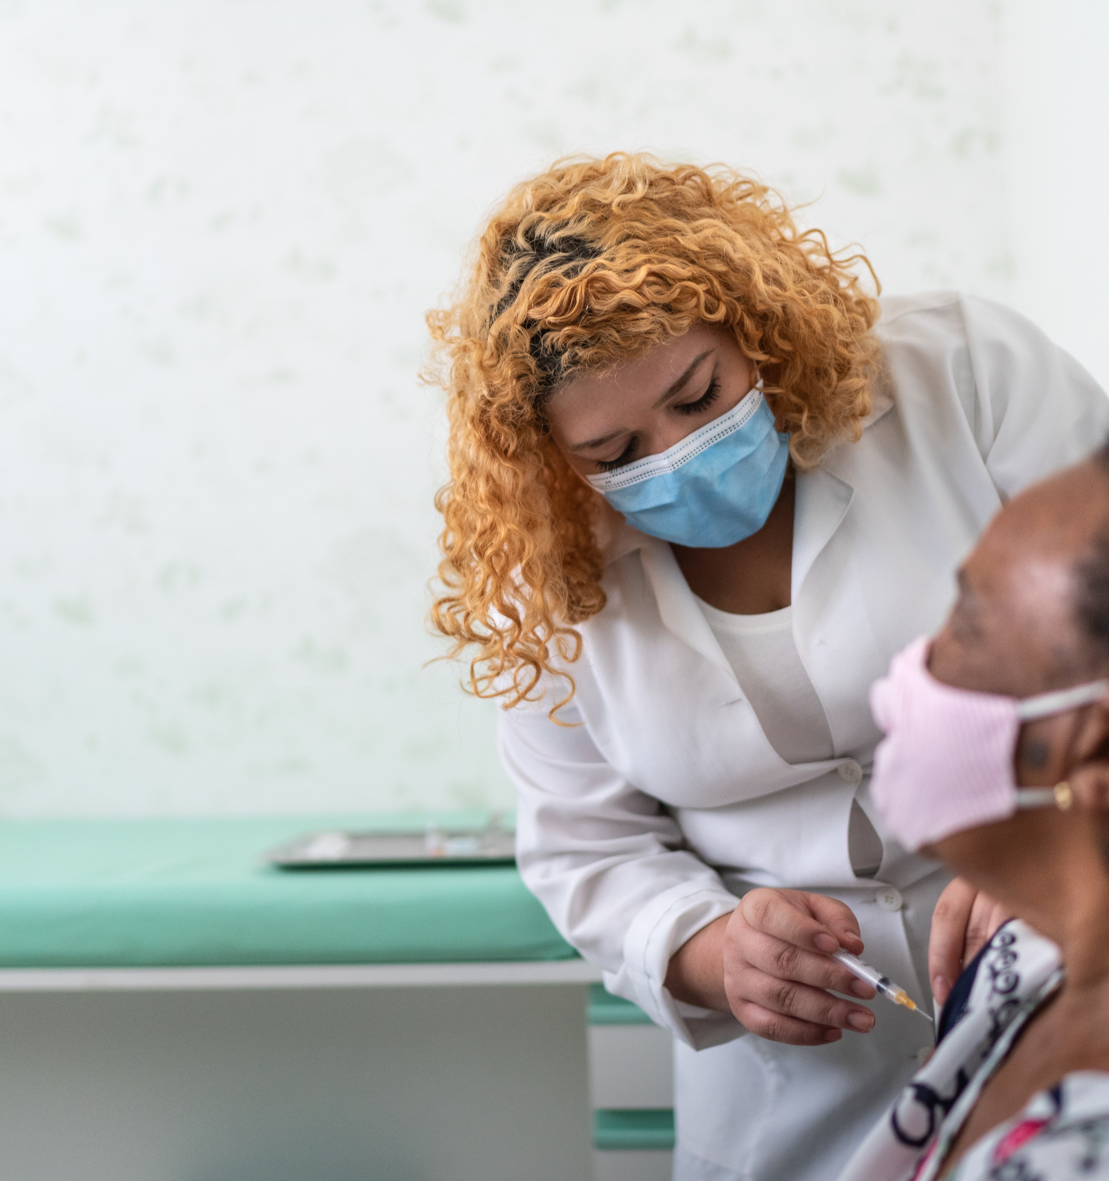
Primary Care
Need for PCP
Recognition of barriers & privilege
Insurance, cost
Language; health literacy
Differently abled
Work
Geographic, transportation
PCP availability, quality
LGBTQAI+
Other
Notes:
--Disparities in access to primary health care exist = increased risk of poor health outcomes.
--Care may be delayed = more likely to be hospitalized for chronic conditions.
--Lack of health insurance, language barriers, disabilities, inability to take time off work to attend appointments, geographic and transportation-related barriers, and a shortage of primary care providers.
--LGBTQAI+ individuals face health disparities linked to societal stigma & discrimination = associated with higher rates of psychiatric disorders, substance abuse, and suicide. Need trust built with PCP team.
Laura – any difficulty in your experience yourself or with the clients you serve to find a PCP, connect with a PCP, receive quality care from a PCP, afford a PCP, or have time to go see a PCP? ☺ Audience?
--We will review preventive health screenings that should be part of a PCP GME (not problem focused). Refugee health experience – new arrivals may or may not be familiar with preventive health as a concept.

Slide 4
Preventive Health Recommendations (average risk, adults, not pregnant, not immunosuppressed)
Substance use/smoking, IPV, Depression, Falls (65+) - all annually
Hypertension (every 2 yrs 18-39, annually* or 40+ annually)
Obesity (every 2 yrs)
Cancer screening: Colorectal (45 or 50 – 75+, younger*), Prostate (biological males 50+ consider), Cervical (biological females 21-29 every 3 yrs, 30-64 every 3-5 yrs, 65+*), Breast (biological females 40-75+ annually or more*), Lung (50-80 annually*)
Infectious Disease: Hep C (18-79 x 1 or more*), HIV (15-65 x 1 or more*), Chlamydia*, Gonorrhea*, Syphilis*, Hep B*
*If at increased risk. All recommendations should be finalized per your personal medical provider.
Objective: Familiarize listeners with preventive health recommendations & wellness screenings
Notes:
--Two slides to review preventive health screening guidelines. No need to memorize, USPSTF guidelines are available to the public – reference listed in my slide.
--Likely familiar with most of these. Violence & depression screening are often done with questionnaires and not necessarily discussed in person (would add anxiety screening).
--BP can get missed, white coat syndrome.
--Obesity prevalence 42.4% in 2017-2018 (associated with heart disease, stroke, type 2 diabetes, some cancers). CDC associates 13 cancers w/overweight & obesity: meningioma, adenocarcinoma of the esophagus, multiple myeloma, kidneys, uterus, ovaries, colon and rectum, pancreas, upper stomach, liver, gallbladder, breast (post-menopausal women), and thyroid.
--Prostate ca – more on a subsequent slide.
--Colorectal consider as young adult if high risk. Insurance may not agree with 45 yo.
--Breast – varies by guideline when to start and how frequently to screen (Breast cancer screening per Mayo Clinic typically will start at age 40.
There are risk assessment tools that can be used to determined increased risk and need for prior screening (IBIS). Consider breast density level. MBI. Show of hands for those willing – how many 40+ are familiar with breast density?
What about MRI? Consider BRCA mutation carrier or other genetic mutations, first-degree relative of BRCA mutation but has not been tested. Hormone replacement therapy history. Ovarian cancer personal history. Prior breast biopsy. Ashkenazi heritage. Radiation to the chest 10-30 years old.
Breast cancer is the most common cancer in American women, except for skin cancers. Currently, the average risk of a woman in the United States developing breast cancer sometime in her life is about 13%. This means there is a 1 in 8 chance she will develop breast cancer).
--Cervical (Pap smear) depends on age and HPV co-testing. Exceptions – symptoms, DES daughter, immunosuppressed, abnormal Paps etc.
--Lung – 20+ pack hx. Low dose CT annually. Would advise years of anything smoked. Quit in last 15 years or smoking now.
--A lot of info – pause for Q’s.

Slide 5
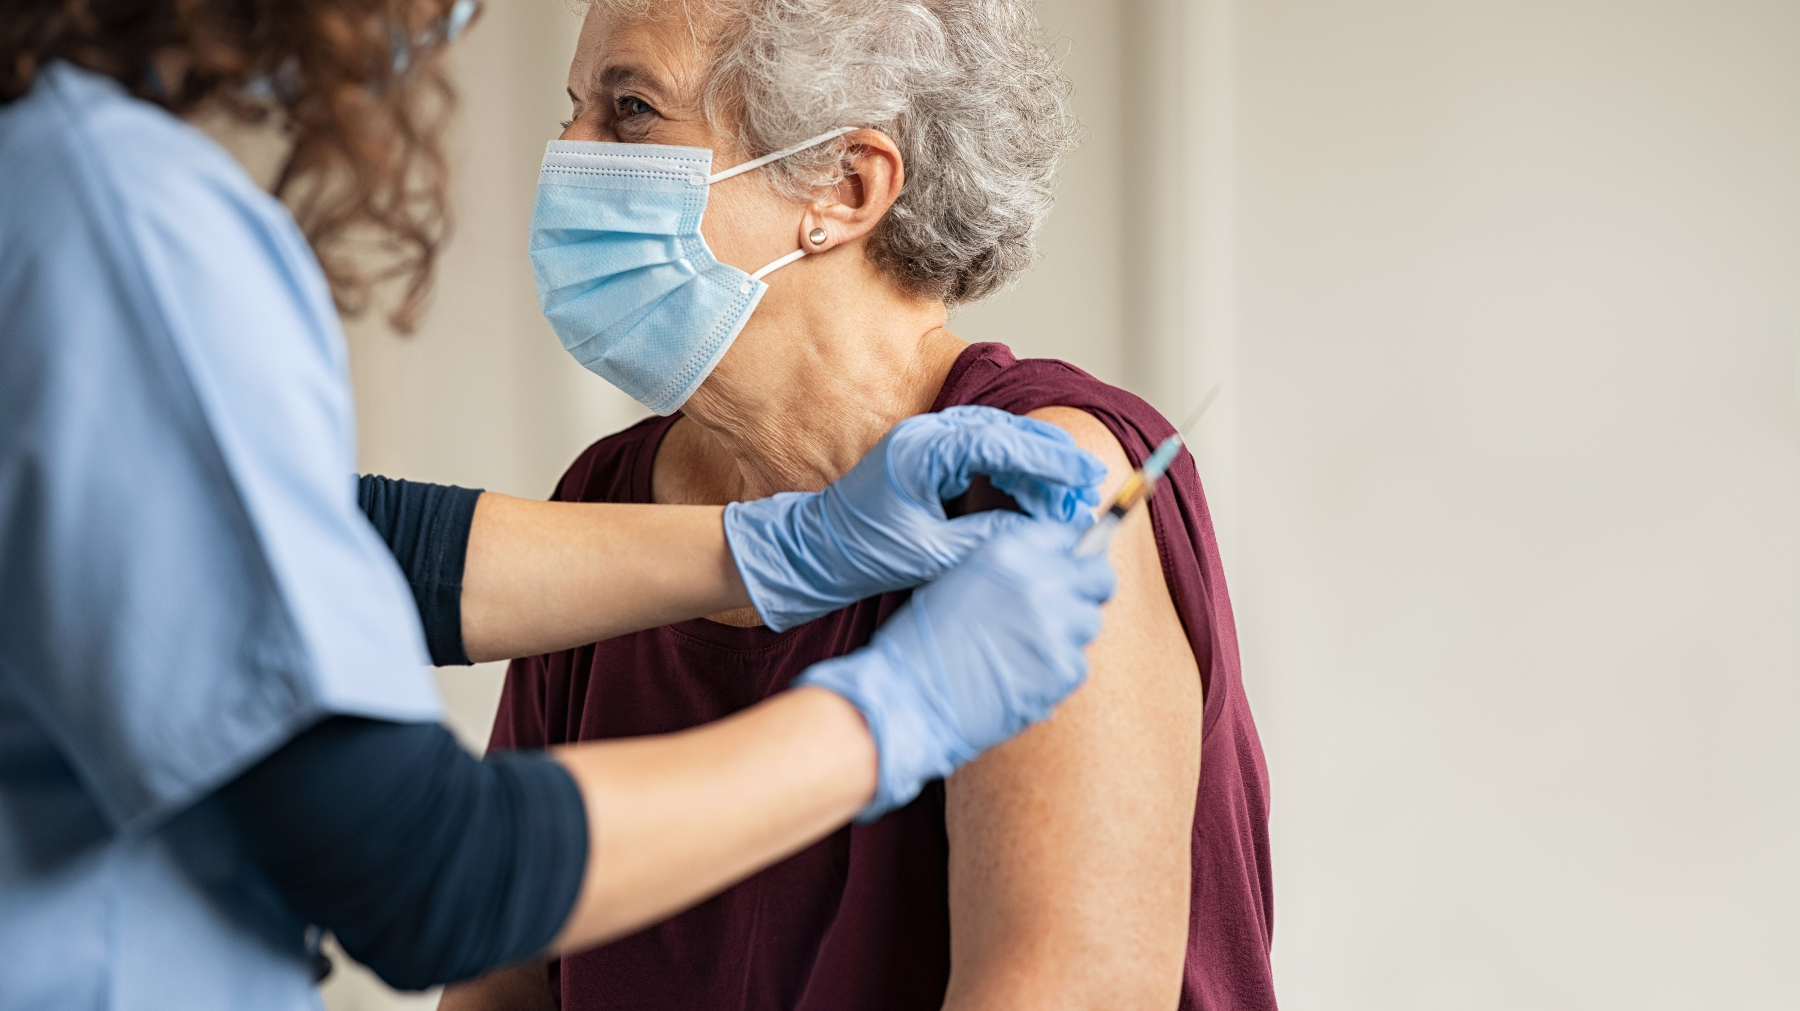
Preventive Health Recommendations, con’t (average risk, adults, not pregnant, not immunosuppressed)
Other: AAA* (biological males 65-75 x 1), Diabetes (18+*, 45+, every 3 years or more*), Hyperlipidemia (20 x 1 or more*, 40+ every 4-6 yrs or more*), Osteoporosis/osteopenia (biological females 50* or 65 x 1 or more* or biological males*)
Vaccinations: PPSV23 & PCV13, Influenza, Tdap or Td, HPV, Herpes zoster (Shingrix), Covid-19, additional* such as Varicella, Hep B, MMR, meningococcal ACWY & B.
*If at increased risk. All recommendations should be finalized per your personal medical provider.
Objective: Familiarize listeners with preventive health recommendations & wellness screenings
Notes:
--Recognition of amount of material – focus on one or two things you might be due for.
--Male smokers > 100 cigarettes/lifetime – AAA screening missed.
(Evaluate risk for abdominal aortic aneurysm
--Screening indications.
An abdominal aortic aneurysm (AAA) is present when the abdominal aortic diameter is >1.5 times the diameter of normal adjacent aorta. In general, AAA diameter is approximately >3.0 cm for males and >2.7 cm for females. Most concern/repair when > 5.0 cm.
Major risk factors include:
Males
Caucasian race
Smoking
Age ≥65 years
Family history of abdominal aortic aneurysm
Lesser risk factors include:
Coronary artery disease
Atherosclerosis
Hypertension
Hypercholesterolemia
High-risk patient screening
In this group, screening results in a relative risk-reduction of AAA-related death of approximately 43%.
--Diabetes screening often more often with higher BMI. Can calculate risk per American Diabetes Association (ADA) with tool including age, gender, 1st degree relative with diabetes, hypertension, physically active, BMI > 25 or >23 in Asians (see tool in references). Remember – risk to vessels/heart for diabetics – most don’t die related to blood sugar episode.
--Lipids – seeing more in younger population.
--Bones – smoking, corticosteroids, stress fractures, early fam hx
--Changes in 2019 guidelines re 23-valent pneumococcal polysaccharide vaccine or Pneumococcal 13-valent conjugate vaccine (PCV13). A lot of info w/these recommendations – happy to discuss more after the talk in the interest of time.
--Questions on second slide of recommendations?

Slide 6
Prostate health
Risk factors for prostate cancer include:
Age ≥50 years
African-American ancestry
History of prostate cancer in a first-degree biological relative (father or brother)
Known genetic mutation
PSA, DRE
Notes:
--Prostate ca: (Benign prostatic hyperplasia is a nonmalignant enlargement of the prostate.
Benign prostatic hyperplasia may be associated with obstructive and irritative lower urinary tract symptoms, including:
Slow urinary stream
Straining to urinate
Intermittent urine flow
Feeling of incomplete emptying
Urinary frequency and urgency
Small voided volumes
Nocturia
Hematuria
Urinary tract infections
Anuria (due to urinary retention)
Prostate cancer is the most common malignancy in adult men:
Prostate cancer is typically asymptomatic in the early stages. Signs and symptoms, when present, may include:
Weight loss
Appetite loss
Hematuria
New or progressive bone pain
Difficulty urinating
Hardened prostate or nodules on the prostate.
RISK: Risk factors for prostate cancer include:
Age ≥50 years
African-American ancestry
History of prostate cancer in a first-degree biological relative (father or brother)
BRCA1, BRCA2, HOXB13 mutation, others.
PSA, DRE

Slide 7
Women’s Heart Health
If you worry excessively about breast or ovarian cancer, your anxiety might be misplaced. Statistically, heart disease might be a more significant health risk.
Notes:
--Statement from Mayo Clinic
--Cardiovascular disease, including coronary heart disease (CHD), is the most common cause of death and disability in women in the United States
--It accounted for 22 percent of all-cause mortality in women in 2013.
--Between the ages of 45 and 64, one in nine women develop symptoms of some form of cardiovascular disease. After age 65, the ratio climbs to one in three women.
--Women may not identify their initial symptoms as an expression of heart disease and therefore may not seek medical advice promptly.
--Medical practitioners may not evaluate symptoms that represent myocardial ischemia as early as in men and women with CHD are generally about 10 years older than men at the time of presentation.
----We will be talking about occupational / work issues & healthy habits next. Let’s pause and I would like to ask Laura to share her thoughts on additional practices that are NOT part of the standard preventive health discussions in GMEs that are just as or even more important. END OF PART ONE, STRETCH BREAK!

Slide 8
Occupational Health
Health-related absenteeism, working while sick or distracted = costly
Healthy work culture & environment = increased engagement in healthy behaviors & health improvement
Healthy workers = increased productivity & better quality work
Stress is associated with chronic disease & mortality
Quality of life, mental health; effect on relationships within & outside of work
Objective: Discuss holistic health as
applicable to life & work performance
Notes:
PART TWO
--Why does health matter at work? I used to work in Occupational Medicine and know that chronic illness and acute injuries can cause weeks, months, or even years of impact on work performance or attendance.
Laura – From an attorney’s perspective, how do you see health issues manifest in the workplace or your practice? This can be your own health or that of employees/co-workers.
--Relevant as the employer OR employee. Phone distracting in younger workers
--What is your work culture & environment like? What could be changed? Access to wellness programs?
--Taking time for wellness = more productive. Is work-life balance as an attorney a priority for you and if so, why not?
--Optional – The activation of the sympathetic-adrenal-medullary system releases catecholamine = helps regulate the cardiovascular, immune and respiratory systems. Cortisol is an end product of hypothalamic-pituitary-adrenal (HPA) axis signaling and influences metabolic functioning and the immune system which is fine but when prolonged = dysregulation of the stress response system = adverse biological effects on the body and brain. Changes w/cortisol use seen with stress events, PTSD, ?chronic disease contributor.

Slide 9
“12 habits of highly healthy people” Objective: Strategize for positive change via setting of wellness goals
Notes:
--Per Mayo Clinic.
--People are often overwhelmed. Risk for high blood pressure, burn out, Weight gain, anxiety, depression, digestive issues, memory issues, heart disease, headaches, etc….
--Sleep & gratitude are two of my favorites of these 12.
--Exercise = move your body. Start low go slow. Recommend goal of 150 minutes per week. Make it play. Include aerobic, strength, balance, & flexibility. HIIT (I like OTF) has cardiac protection.
--Choose ONLY one or two habits to change at a time. Laura – what are your thoughts on top priorities of these habits for attorneys and why?

Slide 10
SMART GOALS
Specific. Avoid broad or vague statements. What does goal look like in your mind?
Measurable. Components to track (ex. duration or frequency of activity). Helps see progress.
Attainable. No marathons tomorrow – but maybe a 5K in six weeks...
Relevant. Set goal for YOU, not anyone else.
Time-limited. Realistic deadline. Name an endpoint – can be in steps (consecutive SMART goals).
Objective: Strategize for positive change via setting of wellness goals
Notes:
--NOT just, “I want to be healthy.”
--SMART GOAL: I do want to lose weight, but I can see myself focusing on mental health to start. I am really busy but I think starting a mindfulness practice 3 times per week for 5-10 minutes per session is attainable. I can track it in a journal by my bed or in an app. This is important and relevant to me because I know that other pieces of my health like my emotional eating and my sedentary lifestyle improve once I get my mind centered. I will do this practice for two weeks successfully before adding any more change.

Slide 11
Holistic Health for Attorneys
What if it wasn’t you?
Case
Guidance from panel & audience
Discussion on importance of what/how we eat, our sleep, & moving our bodies
Objective: Collaborate as presenters to share suggestions on nutrition, sleep, & exercise
Notes:
--Successful & busy professionals – importance of physical, mental, emotional, and spiritual health. I find that my inner voice is not as kind and attentive as my outer one to my family, my colleagues, and my patients.
--I want you to imagine a fictional lawyer who needs guidance from all of you on her preventive health & wellness. What would you prioritize for her given the following quick history –
--This attorney is 42 years old, has two teenage children, & she is single. She lives in Minneapolis, MN where she practices immigration law at a medium sized firm. She averages 6 hours of sleep per night, feels tired during the day & has trouble focusing on tasks. Her employer has suggested she use some of her time off but she has not. She has access to a yoga mat & free weights in her house but does not use them. She has gained 15 lb in the past 3 months and thinks this is from drinking more mochas on the go but her BMI is now 29. She has not had a GME in 3 years, had a brief sexual relationship 2 months ago without barrier use, has a strong family history of early onset diabetes, and thinks perhaps she is experiencing anhedonia.
Laura – What would you suggest for this woman to prioritize for preventive health screenings? Is she at risk for health complications? What does the audience think – can you relate at all?
(I would suggest she needs breast cancer screening, blood pressure check, cholesterol and blood sugar checked, counseling on weight, depression screening, exercise guidance, vaccinations if due, STI screening with Pap smear if due).
What do you do in your attorney practices to incorporate good nutrition, adequate sleep, and regular exercise – and what would you suggest this attorney do?
Why are these things important to you and how do you accomplish balance and consistency?
Optional: --Diet needs to be accessible, affordable, sustainable, enjoyed. Mediterranean diet or DASH per Mayo. Intermittent fasting - no large, randomized control trials examining the relationship between intermittent fasting and cardiovascular outcomes, current human studies suggest this diet could reduce the risk for cardiovascular disease with improvement in weight control, hypertension, dyslipidemia, and diabetes (Possibly via multiple pathways: reducing oxidative stress, optimization of circadian rhythms, and ketogenesis). Ongoing research for long-term effects of ketogenic diet, sustainability. Avoid restrictive behavior if tendencies toward or hx of EDO.
--To wrap up, Laura will share her insights on overuse behaviors and strategies to combat these.

Slide 12
Overuse behaviors
What defines overuse/addiction?
What habits may be barriers to our health goals?
What strategies/tips can be utilized to decrease overuse?
Notes:
Per Laura

Slide 13
References
Access to Primary Care. (2014). Access to primary care - healthy people 2020. HealthyPeople.gov. Retrieved October 27, 2021, from https://www.healthypeople.gov/2020/topics-objectives/topic/social-determinants-health/interventions-resources/access-to-primary
American Diabetes Association (ADA) Risk Calculator. (2021). American diabetes association (ada) risk calculator - mdcalc. MDcalc.com. Retrieved October 27, 2021, from https://www.mdcalc.com/american-diabetes-association-ada-risk-calculator
Ask Mayo Expert. (2021, August 21). Screening, immunization, and prevention (adult). askmayoexpert.mayoclinic.org. Retrieved November 7, 2021, from https://askmayoexpert.mayoclinic.org/topic/clinical-answers/cnt-20144123/tbl-20144277
Bialowolski, P., McNeely, E., VanderWeele, T. J., & Weziak-Bialowolska, D. (2020). Ill health and distraction at work: Costs and drivers for productivity loss. PloS one, 15(3), e0230562. https://doi.org/10.1371/journal.pone.0230562
Centers for Disease Control and Preventiion. (2021, September 30). Adult obesity facts. Centers for Disease Control and Prevention. Retrieved October 27, 2021, from https://www.cdc.gov/obesity/data/adult.html
Centers for Disease Control and Prevention. (2021, March 10). Obesity and cancer. www.cdc.gov. Retrieved October 27, 2021, from https://www.cdc.gov/cancer/obesity/index.htm
Cohen S, Janicki-Deverts D, Miller GE. Psychological Stress and Disease. JAMA. 2007;298(14):1685–1687. doi:10.1001/jama.298.14.1685
Consensus Statement of the Health Enhancement Research Organization, American College of Occupational and Environmental Medicine, American Cancer Society and American Cancer Society Cancer Action Network, American Diabetes Association, & American Heart Association (2012). Guidance for a reasonably designed, employer-sponsored wellness program using outcomes-based incentives. Journal of occupational and environmental medicine, 54(7), 889–896. https://doi.org/10.1097/JOM.0b013e3182620214
Dan Abraham Healthy Living Center. (n.d.). 12 Habits for well-being. dahlc.mayoclinic.org. Retrieved August 2, 2019, from https://dahlc.mayoclinic.org/hubcap/12-habits-of-highly-healthy-people/
Freedland, S. (2021). Measurement of prostate-specific antigen (M. P. O'Leary & J. Givens, Eds.). UpToDate. Retrieved November 14, 2021, from https://www.uptodate.com/contents/measurement-of-prostate-specific-antigen
Healthy people 2020. (2021, October 27). Lesbian, gay, bisexual, and transgender health: healthy people 2020. healthypeople.gov. Retrieved November 7, 2021, from https://www.healthypeople.gov/2020/topics
Pagidipati, N., & Douglas, P. S. (2019). Clinical features and diagnosis of coronary heart disease in women (J. C. Kaski, P. A. Pellikka, & N. Parikh, Eds.). UpToDate. Retrieved November 14, 2021, from https://www.uptodate.com/contents/clinical-features-and-diagnosis-of-coronary-heart-disease-in-women-objectives/topic/lesbian-gay-bisexual-and-transgender-health
Peterson, S. M. (2016, November 30). 3 ways to get closer to achieving your goals. MayoClinic.org. Retrieved August 2, 2019, from https://www.mayoclinic.org/healthy-lifestyle/adult-health/in-depth/ways-get-closer-achieving-goals/art-20267230
Steel, J., Godderis, L., & Luyten, J. (2018). Productivity estimation in economic evaluations of occupational health and safety interventions: a systematic review. Scandinavian journal of work, environment & health, 44(5), 458–474. https://doi.org/10.5271/sjweh.3715
United States Preventive Services Task Force. (2021). USPSTF A and B recommendations. Uspreventiveservicestaskforce.org. Retrieved 10/27/2021, from https://www.uspreventiveservicestaskforce.org/uspstf/recommendation-topics/uspstf-and-b-recommendations
*All images used in presentation were from Power Point stock images*
Notes:
Special thanks – Becca, Laura.
References, THANK YOU, open for discussion…!

