Slide 1



BALANCING
YOUR PRACTICE, YOUR CLIENTS, and YOUR WELL-BEING
WELLNESS IN IMMIGRATION PRACTICE
November 18-21, 2021 | Cabo San Lucas, Mexico

Slide 2

MANAGING YOUR IMMIGRATION PRACTICE

Slide 3

MANAGING YOUR IMMIGRATION PRACTICE
Technology
Immigration Resources
Staff – Hiring, Training, Maintaining, Peer and Supervisory Review, Value, Salary
Benefits

Slide 4

MANAGING YOUR IMMIGRATION PRACTICE
Production – Case Flow
Marketing
Financial Responsibility
Keeping the Balance between working efficiently, keeping the client happy, and being profitable

Slide 5

CLIENTS

Slide 6
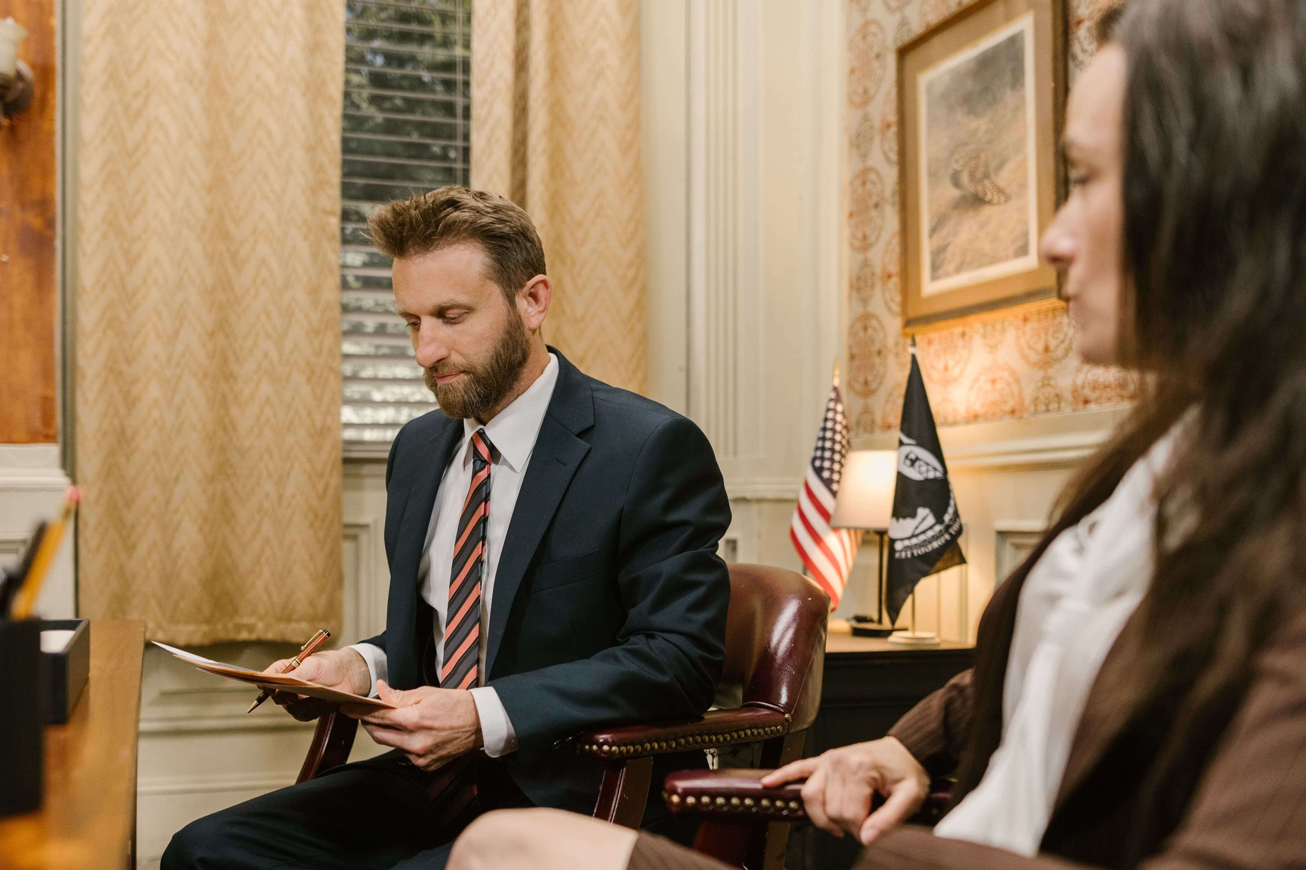
CLIENTS
Evaluate short and long-term objectives
The importance of strategy
Communication and honesty
Client must have a clear understanding and agreement with the legal strategy and throughout the process.
Keep clients informed of the progress of the case.

Slide 7

CLIENTS
There are NO GUARANTEES for any legal process, no matter how sure we are that the client is eligible to obtain the benefit. Client must know and understand this concept.
Manage client expectations.

Slide 8
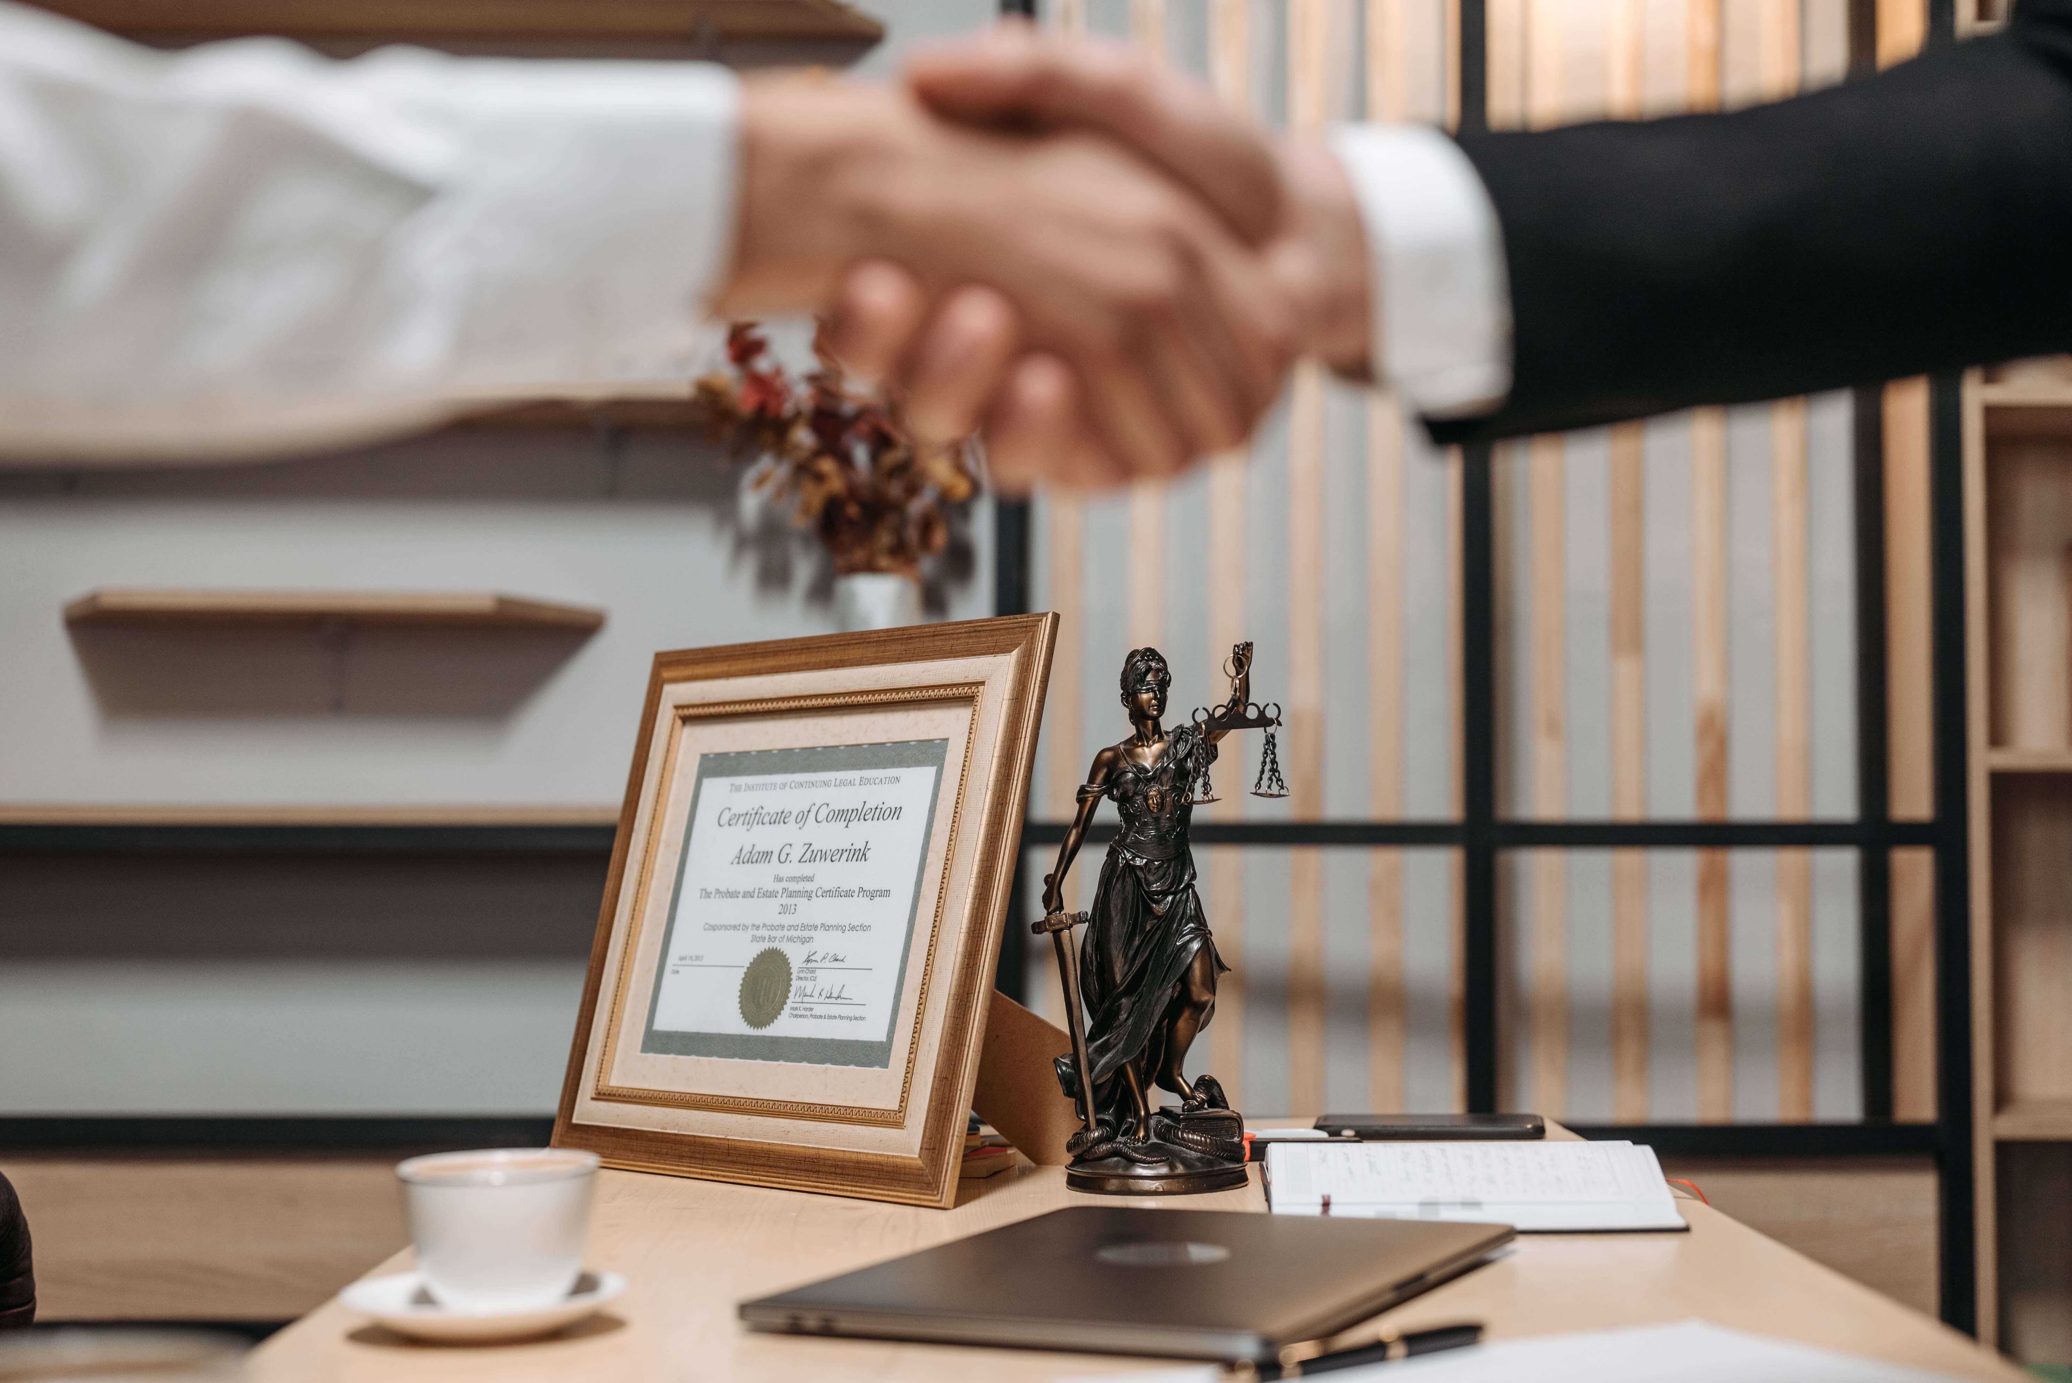
THE IDEAL CLIENT

Slide 9

THE
IDEAL
CLIENT
Understands legal options and communicates professionally with you and your staff
Follows your recommendations
Provides documents timely
Does not keep information from you
Pays on time
Does not complain or fault you for a negative government decision or request for additional evidence

Slide 10
THE DIFFICULT CLIENT

Slide 11

THE
DIFFICULT
CLIENT
Is critical of every step and everyone working on his case
Is rude to the staff
Demands quick service
Is slow to pay or reminds you that he has paid
Will throw you under the bus without a though

Slide 12
THE
DIFFICULT
CLIENT
Clients demand efficient service, and we should deliver within reason
Be willing to talk to client immediately when a crisis arises
Offer solutions
Long client relationships are based on trust, always
HOW DO YOU HANDLE A DIFFICULT CLIENT?

Slide 13

OUR WELL-BEING

Slide 14

OUR
WELL-BEING
Taking Care of Ourselves – Mentally and Physically
Spend Time with Family and Friends
Exercise
Book, Trivia or Dinner Club
Try to have fun and disconnect from the office

Slide 15

Keep Calm and Carry On!
Silvia Graves
Graves & Graves, P.C. Attorneys and Counselors at Law
5599 San Felipe Street, Ste. 500
Houston, Texas 77056
(713) 784-9204
Beatriz Trillos-Ballerini
Trillos Ballerini Law Firm, P.C.
3000 Weslayan Street, Ste. 210
Houston, Texas 77027
(713) 739-7272

