Slide 1

Promoting Wellness and Balance
In the office & in the profession
Dustin O’Quinn : Lane Powell, P.C. : Seattle, WA

Slide 2

How to Bring it all Together & Promote Health in Your Firm
Promoting Health
Balanced With What?
  Profits
  Client Satisfaction
  Administrative Tasks
  Home & Family

Slide 3
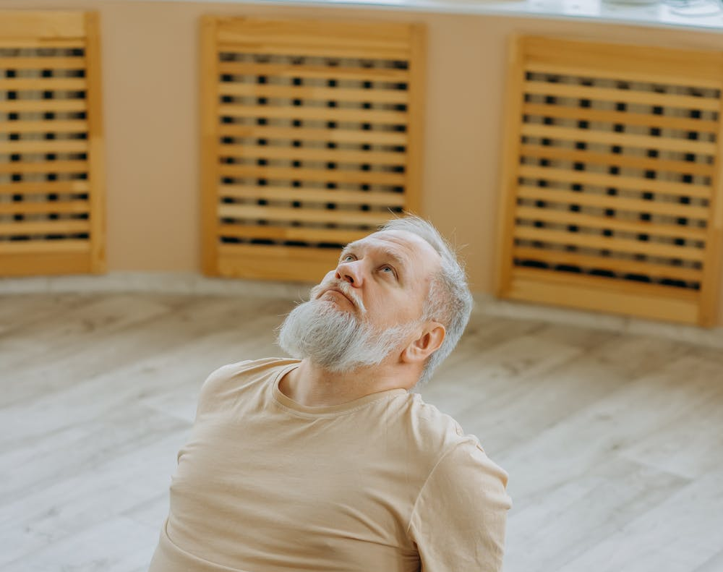
So How Do You Balance?
Decide to Do It and Do It
Dustin’s Story
Norma’s Story
Your Story?

Slide 4

Determination
“I’m going to work 12 hours per day no matter what!”
“I’m going to leave at 5:15 on Tuesday through Friday, no matter what!”
I’m going to wake up at 4:45 am on Monday, Wednesday, and Friday. . . no matter what!”

Slide 5


Determination, not Obsession

Slide 6

Resources
TX Lawyers Assistance Program
  https://www.tlaphelps.org/
SBNM, Judges and Lawyers Assistance Program:
  https://www.sbnm.org/Member-Services/Judges-and-Lawyers-Assistance-Program
OBA, Lawyers Helping Lawyers:
  Https://www.okbar.org/lhl/
AILA, Lawyer Wellbeing Center:
  https://www.aila.org/practice/lawyer-well-being-center

Slide 7
How to Find Opportunities to Lift Each Other Up
And Shift The narrative

Slide 8
Lifting Up Your Team
Gratitude

Slide 9

Lifting Up Your Team
Day to Day gratitude
  Words
  Awards
Bonuses
Equity
  Ideologically
  Financial
Other ideas?

Slide 10
Let’s Lift Each Other Up
Ideas

Slide 11

Online
LinkedIn
Instagram
Facebook/Meta (?)
Lawyer search sites

Slide 12

In-Person
Happy Hours
Breakfast Meetings
Personal Notes
Referrals

Slide 13

Awards
Sujata Ajmera
  Austin 40 Under 40
  Austinite of the Year
  UT Young Alumni 2021

Slide 14
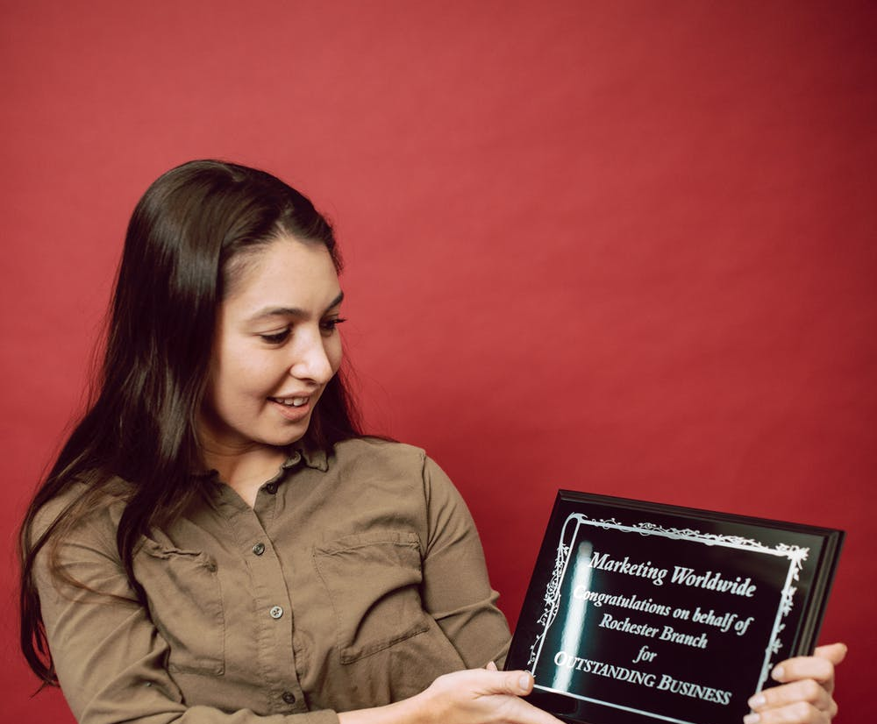
Awards
Your School
AILA
State Bar
Municipal
Olsa, Rebecca, and Magali

