Slide 1
Personal Finance for Lawyers
Achieving financial health through health coaching.
AILA Texas, New Mexico, and Oklahoma Fall Conference, 2021
Cabo San Lucas, Mexico
Craig Dobson
National Board Certified Health & Wellness Coach
Ethics lawyer licensed in New York and Georgia
craig@dobson-law.com
912-335-4488
Magali Suarez Candler
Suarez Candler Law, PLLC
mcandler@suarezcandlerlaw.com
713-672-2624

Slide 2
Possible Philosophies of Lawyering
Dimension | Philosophy | Philosophy | Philosophy | Philosophy
Personal | Personal Life Primary | Balanced | Committed to Work
Practice | Lawyer Self-Interest | Client-Centered | Moral Values | Institutional Values
Professional | Removed | Involved | Dedicated
Using the Concept of “A Philosophy of Lawyering” in Teaching Professional Responsibility, Nathan M. Crystal, St. Louis University Law Journal, Vol. 51:1235 at 1246 (Chart 4)

Slide 3
Most Causes of Illness are Related to Health Behaviors
Access to Care 10%
Genetics 20%
Environment 20%
Health Behaviors/Lifestyle 50%
U.S. Department of Health and Human Services. Healthy People 2010. 2nd ed. With Understanding and Improving Health and Objectives for Improving Health. 2 vols. Washington, DC: U.S. Government Printing Office. November 2000.

Slide 4
Current State of US Health Care Expenses
75% of US costs ($1.87 Trillion) are spent on chronic, largely preventable diseases
Diabetes
Heart Disease
High Blood Pressure
Cancer
40% of all premature deaths in the US are caused by lifestyle choices
60-90% of all physician visits are related to stress
Use of Medical Care for Chronic Conditions, Decker S, Schappart S, Sisk J, Health Affairs, 28(1) 2009

Slide 5
Cardiovascular diseases
kill more people worldwide
each year than all other
illnesses combined.

Slide 6
Heart disease remains the #1 killer of Americans
1.3 m angioplasties, $48k each, $60B in 2006
448,000 bypass, $100k each, $44B in 2006
Angioplasties and stents do not prolong life or prevent heart attacks in stable patients (95% of those who receive them) N Engl J Med 2007
Bypass surgery prolongs life in less than 3%
AND changing lifestyle could prevent at least 90% of all heart disease Lancet. 2004 Sep

Slide 7
95 cents of every dollar was spent to treat disease after it had already occurred

Slide 8
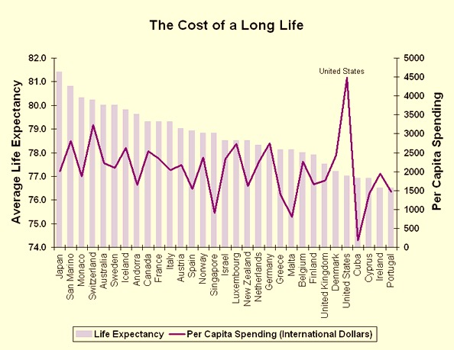
The Economics and the Outcomes
UC Project for Global Inequality

Slide 9
The Real Healthcare Recovery Plan
Chronic conditions consume more than 75% of healthcare costs, and are largely effected by health behaviors.
The current healthcare model doesn’t work because we do not have a core competency in optimizing health.
We have a professional and now an economic imperative to change.

Slide 10
Short Term/Long Term Healthcare
Opportunities for Intervention
Baseline Risk
Initiating Events
Earliest Molecular Detection
Earliest Clinical Detection
Typical Current Intervention
Cost
1/reversibility
Disease Burden
Time
Source: Ralph Snyderman, MD, Chancellor Emeritus, Duke University

Slide 11
Integrative Medicine: A Transformative Model
Contemporary
Disease oriented
Treat symptoms
Find it, fix it
Biomedical interventions/high-tech
Reactive
Sporadic
Individual left to enact
Physician-directed
Integrative Care
Health oriented
Treat symptoms & whole person
Identify risk, minimize it
Whole person approach / high-touch
Proactive
Lifelong planning
Support in implementation
Partnership-based

Slide 12
A Radical Departure
Our current model is problem based and disease oriented
Individuals do not change their lifestyle choices or health behaviors until we know what matters to them
Behavior changes are sustainable when they have deeply personal significance
This calls for a complete change in the mindset and practice of healthcare

Slide 13
Integrative Medicine
Is Patient-centered vs. Disease-centered
Engages all aspects of the person: mind, spirit, body and community
Partners with patient in their care, honoring their values
Supports patient in lifestyle change processes
Is committed to the practice of best medicine, whether the origins are conventional or complementary

Slide 14
The Future of Healthcare: Key Distinctions
Planning for Health
A Focus on Healing
Whole Person Strategies
Coordination of Health Care Across Time
Support in Behavior Changes

Slide 15
Rules for the 21st Century Health Care System
Current Approach
Care based on visits
Professional autonomy drives variability
Professionals control care
New Rule
Care based on continuous healing relationships
Care is customized according to patient needs and values
Patient is source of control
Crossing the Quality Chasm, Institute of Medicine, 2001

Slide 16
What is Integrative Health Coaching?
Coaches focus on assisting client to take action in realizing their optimal health goals.
Coaches guide clients through the process of creating a health plan for themselves, taking action, and following through on accomplishing the plan.
Coaches engage clients throughout the whole process by providing challenges and support while still holding the client accountable for meeting their goals.

Slide 17
The Integrative Health Coaching Process
Vision
Values
Assessment
Action
Maintenance
Focus
Readiness to Change
Goal Setting
Preparation for Action

Slide 18
Personalized Health Planning
“Personalized”
To make individual, specifically to mark as property of a particular person
“Health”
State of complete physical, mental, and social well-being and not merely the absence of disease
“Planning”
The establishment of goals, policies, and procedures for a social or economic unit
(Merriam Webster’s dictionary)

Slide 19
Understanding That…
The human mind and body have essential capacities for self-repair that can be supported and enhanced by our life choices and appropriate therapies
Optimal health is a journey more than a destination that requires frequent reassessing and rebalancing

Slide 20
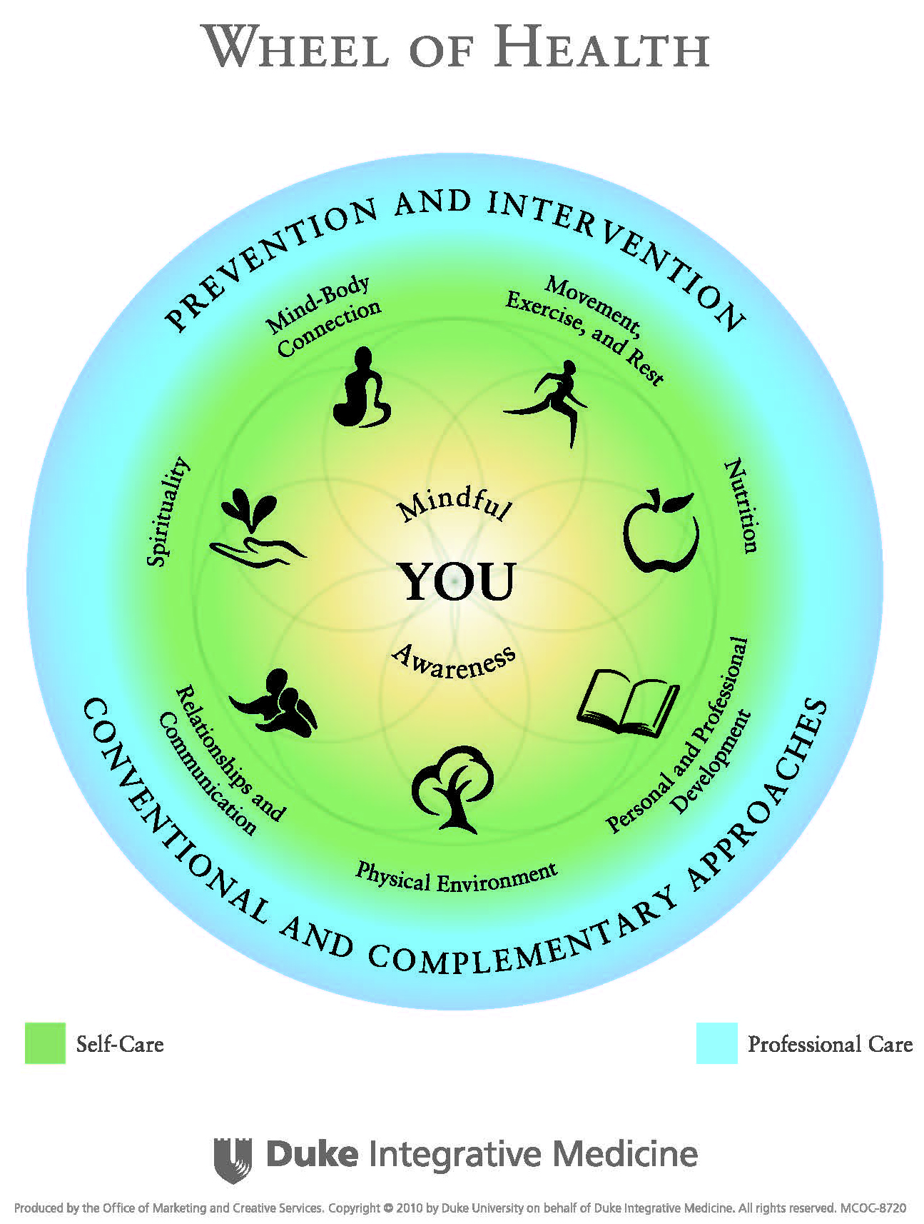

Slide 21
It starts with YOU
Your Values
Your Agenda
Your Goals

Slide 22
Mindful Awareness
Paying attention without judgment
Being mindful, being present
Reconnecting with your body and soul
Reconnecting with your life
You had the event, but did you have the experience?
Constructive, consistent and frequent introspection
Physical, mental, and spiritual self-engagement
Whole person awareness

Slide 23
Mindful Awareness
For the health of your body and your soul:
You can be proactive rather than reactive
You can be present for your life
You can align your outer life to your inner life and live a life that is grounded in a deep sense of meaning and purpose

Slide 24
Domains of Health: Self Care
Movement, Exercise, and Rest
Nutrition
Personal and Professional Development
Physical Environment
Relationships and Communications
Spirituality
Mind Body Connection

Slide 25
Domains of Health: Professional Care
Prevention and Intervention
Conventional and Complementary Approaches

Slide 26
Movement, Exercise & Rest
Enabling the performance of our bodies and minds though movement, exercise and rest
Working our bodies to produce needed strength, flexibility, and endurance
The concept of balance
Importance of restoration and sleep
The joy of movement

Slide 27
Movement, Exercise & Rest
No drug, vitamin, mineral, herb has as many health benefits as exercise
Reduces the risk of:
Osteoporosis and fractures
Heart disease (Hypertension, CAD, hyperipidemia)
Diabetes
Breast cancer
Osteoarthritis
Obesity
PMS
Depression

Slide 28
Movement, Exercise & Rest
Tai Chi and Hip Fractures
Increased balance and awareness
Decreased hip fractures by 47%
Wolf SL et al. Journal of the American Geriatrics Society 1996; 44(5):489–97

Slide 29
Movement, Exercise & Rest
What is your relationship to this domain of health?
How healthy is your balance?
How restorative is your sleep?
Where’s the joy?

Slide 30
Nutrition
Nourishing and strengthening through food and drink
Providing for the body’s energy and nutritional needs
Enjoying the experience of food
Balance in nutrition

Slide 31
Physical Environment
Our surroundings at work and home
Elements we can control
Elements we can modify
Elements we need to accommodate or tolerate

Slide 32
Relationships and Communication
Knowing and communicating with family, friends, co-workers, and colleagues
Hearing and being heard as appropriate in terms of what we think and feel

Slide 33
Relationships and Communication
What does it have to do with health?
Close relationships at every age are associated with a lower risk of dying
Cancer patients with social connections have longer overall survival rates
Lonely or isolated individuals have a four-fold increase in premature death
Married men live longer than single men
Women with pets (not husbands) live longer than women without!

Slide 34
Relationships and Communication
Reflect on your relationships
Do they fuel you? Drain you? What is the balance?
Are there changes you could make? Would like to make?

Slide 35
Spirituality
Attending to spirit and soul and making them relevant in our day to day lives
Connecting the spirit and soul to mind and body and fueling them
How connected do you feel to things outside of yourself?
How connected to you feel to your own self?
Do you have practices that nurture this?

Slide 36
Personal and Professional Development
Development and accomplishment in our personal and work lives
The issues of balance
How much is your life a reflection of who you really are? Do you know?
What is the health of your finances?
Your thoughts about your work or education?
Where do you see yourself in five years?

Slide 37
Finances and Wellness
This is not on Duke’s Wheel of Health, but some say it should have been included since finance is so integral to physical health.
Instead, Duke lists this under Personal and Professional Development.
Certainly, this is an important dimension of Personal and Professional Development.

Slide 38
Physical Environment
Where do you spend most of your time?
What is the quality of air, water, and sound in your environment?
Do they support optimal health?
Are there changes you could make that would create a more nurturing, healthy environment for you?
Pay attention to nurturing each of your senses in your spaces

Slide 39
Mind Body Connection
Strengthening and utilizing the connection between mind and body to strengthen and nourish our whole person
Using the mind as an ally
Using the mind to buffer the body from the effects of stress
Using the mind to reconnect your body and soul and optimize your health, your performance, your life

Slide 40
Prevention and Intervention
Health Optimization
Disease Prevention
Early Detection
Intervention

Slide 41
Conventional and Complementary Approaches
Botanicals and Dietary Supplements
Vitamins
Pharmaceuticals
Surgery
Biologically Based Therapies
Manipulative Based Therapies
Mind Body Based Therapies
Energy Based Therapies
Therapies Based in Complete Systems

Slide 42
What is the Evidence for this Approach?
Working with a Health Coach over time can ensure that you make the lifestyle changes you want to make for a dramatic improvement in your heart health
Edelman D, Oddone EZ, Liebowitz RS, A multidimensional integrative medicine intervention to improve cardiovascular risk. J gen intern med Jul 2006

Slide 43
Creating a Plan
Emergency – experts vary on how much to have, ex. six months to a year.
Create a budget – Craig’s recommendation: Don’t use rough estimates; determine precisely how much cash you have available for the next month and determine how you will allocate that money down to the penny.
Pay off debt – Some experts advise prioritizing this regardless of interest rates. Others advise comparing interest rates with what you gain through investments.
Dave Ramsey’s snowball method

Slide 44
Creating a Plan Continued
Do a monthly financial snapshot that includes:
Everything you own
Everything you owe
Insurance
Health insurance
Disability insurance
Life insurance
More

Slide 45
Creating a Plan Continued
Retirement savings – Are you on track?
After creating and following a budget, do you earn enough money to live life in accordance with your vision and values?
In my experience, the more I develop habits to track and control finances, the more stress goes down.

Slide 46
How to find a Health Coach
National Board Certified Health & Wellness & Coaches
https://nbhwc.org/find-a-certified-coach/#!directory/ord=rnd

Slide 47
Questions?

