Slide 1
Workforce Compliance Is No “Punky Reggae” Party
Kevin Lashus, Austin, TX, FisherBroyles
Amy Peck, Omaha, NE, Jackson Lewis
Kari Konikowski Blackman, Houston, TX, Berry Appleman & Leiden

Slide 2
Discussion Topic s
Form I-9 Compliance and Statistics
E-Verify Requirements, Common Questions and Recent Changes
I-9 and E-Verify Best Practices
Resurgence of Social Security Administration No-Match Letters
Site Visits: Types and Trends

Slide 3
Form I-9 Compliance – In General
Every employee hired after November 6, 1986 must timely complete a Form I-9 to verify identity and work authorization
Section One: Employee must complete on or before 1st day of work for pay
Section Two: Employer must complete within 3 days from 1st day of work for pay
Section Three: Employer must reverify work authorization on or before expiration
Helpful Resources:
M-274, Employer Handbook for Completing Forms I-9: https://www.uscis.gov/i-9-central/handbook-employers-m-274
I-9 Central: uscis.gov/i-9-central (See Questions and Answers)
HSI is increasingly targeting employers with Notices of Inspection to examine Forms I-9

Slide 4
I-9 Compliance: Audit Statistics
Source: U.S. Immigration and Customs Enforcement

Slide 5
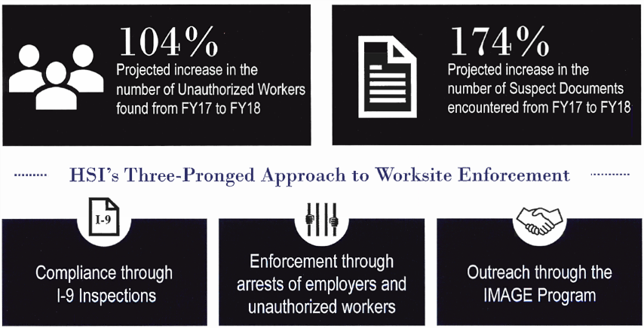
I-9 Compliance: Audit Statistics

Slide 6
E-Verify – In General
Employers electronically confirm the employment eligibility of their employees through a web-based system
Partnership between SSA and USCIS
Steps for verification:
Create cases based on information from employee’s Form I-9
E-Verify then compares I-9 information to DHS and SSA records
Employer usually receives response within a few seconds – confirms employment eligibility or indicates further action needed
Helpful resources:
www.everify.gov
https://www.e-verify.gov/e-verify-user-manual

Slide 7
E-Verify: Requirements
Employee Requirements
Provide SSN on Form I-9
Select List B documents with photo, if provided for Form I-9
Employer Requirements
Use completed Form I-9 prior to submitting E-Verify query
Create E-Verify case by 3rd business day after first day of work for pay
Enter employee e-mail address into E-Verify, if provided for Form I-9
Keep copy of photo matching document, if provided
Best Practice: Know federal and state law re: enrollment requirements
Source: www.Everify.gov

Slide 8
E-Verify: Common Questions
Can E-Verify verify the status of an employee?
Can I terminate employment based on a tentative non-confirmation (TNC)?
Must I terminate employment based on a final non-confirmation (FNC)?
Can I place a STEM OPT student at a third party worksite?
We signed the MOU several years ago and never ran queries on new hires. Should I run the queries now?
We have multiple locations around the world. Are we required to enroll each site?
What are the penalties for noncompliance?
What is SSNVS?
Notes:
Can M&C fine or terminate an E-Verify participant if it finds evidence of misuse, abuse or fraud?
E-Verify will take appropriate administrative measures to assist participants to comply with E-Verify policies and procedures. M&C does not fine employers. However, in certain cases of suspected misuse, abuse, and/or fraud, M&C can recommend that an E-Verify participant be referred to agencies that investigate illegal employer activities
Can my company choose to create E-Verify cases from only one location, even if we hire employees at multiple locations? Yes, you may enroll only the locations that will create E-Verify cases in the E-Verify employer access method. This location can create cases for one or several hiring sites. During enrollment, your company may indicate the number of hiring sites and the name(s) of the program administrator(s) associated with that verification location. You will need to sign only one MOU.
What are the penalties for noncompliance Referral to other agencies; Desk Revie; Site Visit
Third party worksites for STEM OPT: https://ogletree.com/insights/2018-08-23/uscis-reverses-course-allows-stem-opt-students-to-work-at-third-party-sites/

Slide 9
I-9 and E-Verify – Best Practices
Conduct ongoing proactive I-9 audits
Conduct annual training and retain proof of attendance
Proper I-9 completion
Common errors identified through proactive audits
Corrections
Retention
Anti-discrimination
Develop a comprehensive I-9 and E-Verify policy
Add I-9 guidance and E-Verify information to employer communication
Develop protocol to prepare client for Notice of Inspection and/or raid
Remain aware of ongoing changes in I-9 compliance and E-Verify

Slide 10
Social Security No-Match Letters
Notification from SSA that at least 1 employee has a name and/or SSN that doesn’t match SSA records
2007: Bush Administration proposed “safe harbor” rule
Outlined employer’s legal obligations and timeframe
Aimed to protect complying employers against liability
ICE could use receipt of No-Match letter to find constructive knowledge
2009: Obama Administration rescinded
2018: Trump Administration announced renewal of practice
March 2019: SSA issued appx. 570,000 No-match letters
Notes:
https://www.shrm.org/resourcesandtools/hr-topics/talent-acquisition/pages/how-to-respond-to-social-security-no-match-letters.aspx

Slide 11
Social Security No-Match Letters
Recommended steps for employer upon receipt of No-Match letter:
SSA requests corrections within 60 days
Employers register online to review employee names
Inform employee and ask for confirmation of internal records
If needed, provide employees with a “reasonable time” (e.g. 120 days) to contact SSA
Employers must stay in contact with employee to get updates
Correct SSA mismatch
What if an Employee cannot correct?
Constructive Knowledge – Still a concern?
Practical tips

Slide 12
Site Visits: Types and Trends
Fraud Detection and National Security Directorate (FDNS) Site Visits
Generally unannounced
Targets H-1B, L-1, EB-5 at random and all special immigrant religious workers
Goal: Verify compliance with petition terms and conditions
Trend toward site visits related to third party workers
Compliance is voluntary yet encouraged
STEM OPT Site Visits
Generally 48 hours’ notice, with exceptions
Goal is to assess compliance with Training Program
Form I-983: DHS may “deny, revoke, or terminate” STEM OPT for students who are not, or whose employers are not, in compliance

Slide 13
Site Visits: Types and Trends
Litigation associated with site visits
Extensions
TPS and DACA
Expired Form I-9
I-9 enforcement and raids

