Slide 1
BUSINESS FUNDAMENTALS
Immigration Pathways for Foreign Students

Slide 2
Presented By
Lisa Sotelo, Esq.
Elise Healy + Associates, PLLC
Susan Bond, Esq.
The Law Office of Susan Bond, PC
Michael Dominguez, Esq.
Gonzalez Olivieri, LLC

Slide 3
How Can a FN Obtain F-1 Status?
General Requirements for F-1 Visa:
Valid SEVIS Form I-20
School must meet certain requirements to obtain and maintain status as an approved school, eligible to enroll nonimmigrant students, under the SEVIS program
Must obtain I-20 from Designated School Officials (DSOs)
School officials authorized to issue I-20
Caution: the DSO’s can sometimes give prospective students bad or incomplete advice
Nonimmigrant intent
F-1 student must intend to return to country of residence
Must show sufficient ties to home country and financial resources to attend school in U.S. without having to seek employment (at least initially) (See 9 FAM 402.5)
Can be difficult for some folks to apply for F-1 Visa abroad, since consular officer has a lot of discretion when it comes to denying an F-1 student visa

Slide 4
So why not obtain a COS in the U.S.?
Successfully submitting a COS in the U.S. involves properly timing your application.
Cannot attend school while on B-1/B-2 status
Must be conscious of the interplay between intent at admission and timely filing your COS
Must maintain B-1/B-2 status while I-539 is pending
Must request extension by filing I-539 again if
Current status will expire more than 30 days before the initial F-1program start date.
Program start date deferred to following academic term or semester because USCIS did not adjudicate I-539 before original, intended start date.
Must pay separate filing fee for each request
If you do not file this extension request on time, change of status will be denied!

Slide 5
Maintaining F-1 Status
While in United States, F-1 student must:
Maintain a full course of study
This means different things for different levels of schooling
Study at the school designated on Form I-20, only
Engage in authorized employment, only

Slide 6
Entering the U.S. on a F-1 Visa
Student will receive Form I-94 upon entry into the United States
I-94 will not list a specific expiration date
Will be marked with "D/S," meaning the visitor's stay is authorized for the duration of status of the school program, as listed on the I-20
Students are admitted until the expiration of the I-20, plus a 60-day grace period
After entering the U.S on an F-1 visa, student must maintain a full course of study
Study at the school designated on Form I-20, only
Engage in authorized employment, only

Slide 7
CPT, OPT, and stem opt
Curricular Practical Training (CPT)
Must be integral to the established curriculum, such as:
Work/study, internship, cooperative education, or any type of required internship or practicum
Student may begin CPT after receiving Form I-20 with the DSO endorsement
No EAD required (See 8 CFR Section 214.2(f)(10)(i))
Optional Practical Training (OPT)
Practical training directly related to student's major area of study that occurs:
During vacation/when school is not in session
While school is in session, but not to exceed 20 hours/week
After completion of all course requirements (excluding thesis) for bachelor's, master's, or doctoral degree program
Or after completion of course of study (See 8 CFR Section 214.2(f)(10)(ii))

Slide 8
CPT, OPT, and stem opt
To begin work pursuant to OPT:
F-1 student must have an EAD
Except for F-1 students with a science, technology, engineering or mathematics (STEM) degree
STEM Students
Eligible for a 24-month extension of post-completion OPT
Totaling 36 months of OPT
To qualify for a 24-month STEM extension, F-1 student needs to be employed by an employer enrolled in E-Verify
F-1 students cannot have 90 days of continuous unemployment or 120 days of aggregate unemployment while on OPT!

Slide 9
CPT, OPT, and stem opt
For post-completion OPT:
Student must file Form I-765, Application for Employment Authorization
Up to 90 days prior to the program end-date, and no later than 60 days after the program end-date
For pre-completion OPT:
Student may file up to 90 days before being enrolled for one academic year
Provided that the work will not start until the student has completed one full academic year

Slide 10
CPT, OPT, and stem opt
Application: Form I-765
Category (c)(3)(A) for pre-completion OPT
Category (c)(3)(B) for post completion OPT
Category (c)(3)(C) for the 24-month STEM student extension
Must be accompanied by:
$495 filing fee Copy of Form I-94
Two passport photos
Copy of prior EAD, front and back (if applicable)

Slide 11
CPT, OPT, and stem opt
For STEM extensions:
Copy of degree
Proof that employer sponsor is enrolled in the E-verify program
Filing:
Applications are filed at USCIS's Phoenix or Dallas Lockbox based on home address

Slide 12
To E-Verify or Not E-verify
Employers need to consider all of the pros and cons before signing up for E-Verify
The Qualifying Employer:
Must be enrolled in E-Verify and have an Internal Revenue Service (IRS) Employer Identification Number (EIN)
Must have sufficient resources and professional staff available to provide the training specified in Form I-983
By signing the Form I-983 Training Plan:
Employer agrees to wage and working conditions requirements supervision and evaluation (including periodic “validation reports” to the DSO) requirements, and reporting obligations set forth on the form and in the regulations
Also agrees to site visits by DHS!!

Slide 13
To E-Verify or Not E-verify
The Required Training Plan (Form I-983)
Must be completed and signed by the student and employer and submitted to “a Designated School Official at the institution of the student’s most recent enrollment”
The institution that manages the student’s post-completion OPT SEVIS record and will manage the student’s STEM OPT extension record
DSO’s role is to determine that the training plan is “complete, signed, and addresses all of the program requirements”
Plan need not be submitted to USCIS with Form I-765, but USCIS may request a copy

Slide 14
To E-Verify or Not E-verify
Employers should pay particular attention to Section 4, “employer certification”
Employer will have to attest it will notify DSO of changes to the training plan
Including a reduction in the student’s compensation or hours to be worked
And notify DSO within five days of student’s termination or departure
Employer also attests training opportunity is directly related to the qualifying degree
Student will receive on-site supervision by experienced and knowledgeable staff, and the employer will implement the training plan and has sufficient resources and professional staff to do so
Also must pay special attention to Section 4d
Attestations that the student is not displacing a U.S. worker and the student’s hours, duties, and compensation are commensurate to those of the employer’s similarly situated U.S. workers

Slide 15
Possibilities of Rescinding OPT?
Although legal and economic justifications would be weak or even unlawful, Trump administration may soon attempt to eliminate via regulation STEM OPT
Primary way U.S. allows F-1 international students in STEM fields to work after graduation
Sources indicate Trump administration is poised to end STEM OPT, which allows international students in STEM fields to work 3 years after graduation
An additional 2 years beyond the 12 months of work authorization allowed under OPT for foreign students
The additional 2 years for STEM students have proven vital
They provide international students potentially 3 chances to obtain H-1B status
H-1B visas are generally the only practical way a foreign national can work long term in the U.S.
Legal case for maintaining STEM OPT is strong
"A federal court has already held DHS had the statutory authority to publish a rule extending OPT to students in STEM fields.”
Stephen Yale-Loehr, professor of immigration law practice at Cornell Law School

Slide 16
The H-1B Cap Gap
Any F-1 student with a timely filed H-1B petition and request for change of status will be allowed to extend the duration of F-1 status and any current employment authorization until the first day of the new fiscal year.
Basically, this means that if the student is within their 60 day grace period, or if they are currently on OPT and the work authorization is still valid on the day that they apply for an H-1B change of status, they can remain in the U.S. and continue to work.
If their OPT work authorization expires before they apply for a change of status, but they are still in F-1 status, they are still eligible to remain in the U.S. but they no longer have work authorization.

Slide 17
Strategies for Maintaining Work Authorization while Rolling the H Cap Dice
As noted above, for the time being at least, certain OPT students may have up to three chances to apply for an H-1B visa
However, not everyone qualifies for a STEM OPT 24-month extension
Currently, there are several treaty specific visas available to the citizens of multiple countries
For instance, citizens of Mexico and Canada may work in the U.S. with a TN visa
NAFTA treaty defines which professions may apply for this visa
Citizens of Singapore and Chile have access to an H-1B1 visa
Citizens of Australia may also apply for E-3 visa

Slide 18
New trends in the H1b world
Changes in the H1B landscape
The new normal - Recent decisions and what we have learned
Bulletproofing your petition to address new trends
Strategies for successful RFE rebuttals
Practice considerations

Slide 19
Breaking news . . .
March 31, 2017 – USCIS Policy Memo: H1B Computer Related Positions Rescission
On April 18, 2017, President Trump issued Executive Order 13788 (EO 13788) known as “Buy American and Hire American.” The overall focus of EO 13788 is to encourage the hiring of U.S. workers and to rigorously enforce the current Immigration and Nationality Act. Further, EO 13788 called for the Department of Homeland Security to reform the H-1B nonimmigrant program.
(re)Introduction of legislative proposals that will clamp down on immigration, including employment based immigration
USCIS policy changes with regard to H1B adjudications in an effort to comply with the EO’s directives.
The RFE issuance rate on H1B petitions is WAY UP – 45% increase over the same period last year
June 2017 Secretary of Labor Acosta announced actions to increase protections to American workers while more aggressively confronting entities committing visa program fraud and abuse

Slide 20
Stories from the battlefield
The new normal:
Wage level challenges
Wage compliance issues
Departure from 2015 policy regarding deference to prior determinations
Specialty occupation challenges
45% increase in RFE issuance in H-1B petitions across the board

Slide 21
In the face of denial
A study of case samples
Civil Engineer
Sales Engineer
Operations Research Analyst

Slide 22
What have we learned?
Common RFE themes:
The LCA does not correspond to the petition: duties are beyond a level 1 wage assignment
The job offered does not appear to be a specialty occupation – entry level jobs do not always require a degree in a specific specialty
The job offered does not appear to be a specialty occupation – the job permits more than one field of study
Combination RFEs:
Level 1 + specialty occupation + requested validity period

Slide 23
What’s in your arsenal?
Organizational charts and employee rosters
Expert letters
Supplemental employer support letters
Prior recruitment
Industry job postings
Employer profile, marketing materials, product samples, etc.
The job description
Transcripts and course descriptions

Slide 24
A winning approach
Organize your evidence
Outline your brief
Collect your case law, regulatory and statutory support, and case examples
Draft your supplemental support letters
Examine and qualify your experts

Slide 25
Prepare for battle beyond the rfe
Know the law
Understand your burden of proof
Carefully examine the RFE – read it again. and again. and again.
Outline your arguments in anticipation of litigation
Counsel your client and explain costs

Slide 26
Resources
Standard of proof
Preponderance of the Evidence – Matter of Chawathe, 25 I&N Dec 369, 375 (AAO 2010); USCIS Adjudicator’s Field Manual (AFM), ch. 11.1(c)
Expert testimony – Matter of Skirball Cultural Center, Interim Decision 3752, 25 I&N Dec. 299 (AAO 2012)
Standard of review
Specialty occupation defined – 8 CFR 214.2(h)(4)(ii)-(iii); 8 USC 1184(i)(1)
Bachelor’s is normal to the position;
Degree requirement common to the industry;
Employer normally requires the degree;
Duties are so complex that the degree is required

Slide 27
Resources, cont.
The LCA – 8 USC 1182(n); 8 CFR 214.2(h)(4)(i)(B)(1); 20 CFR 655.705; Employment and Training Administration, Prevailing Wage Determination Policy Guidance (revised Nov 2009)
Jurisdiction
INA 214(i)(1)
8 CFR 214.2(h)(4)(i)(B)(2)
8 CFR 214.2(h)(4)(i)(B)
8 CFR 214.2(h)(4)(iii)(A)
Decision of the Administrative Appeals in Aditi Corporation (LIN9924350365 (May 23, 2000)
June 8, 1995 Memo by John W Brown, Acting Chief, Nonimmigrant Branch, INS Office of Adjudications
November 13, 1995 Memo by Louis D Crocetti, Jr., Associate Commissioner, Office of Examinations
April 12, 1994 Legal Opinion published by INS Office of General Counsel
Wage Level Selection is a Mathematical Calculation – listen to your teacher and show your steps.
Know your Occupational Code

Slide 28
Resources, cont.
The expert letter
Qualify your expert
Where and how to use it
Source your letter writers and compare samples/prices/turnaround times
Don’t leave out your claim
You met the standard of proof, satisfied the standard of review, proved your wage level calculation
Examine and consider pointing out violation of APA at 5 USC 553(a)-(c) for changing regulations without comment; examine and assert imposition of nonexistent wage level requirements, etc. are ultra vires of the statute and not permitted by law

Slide 29
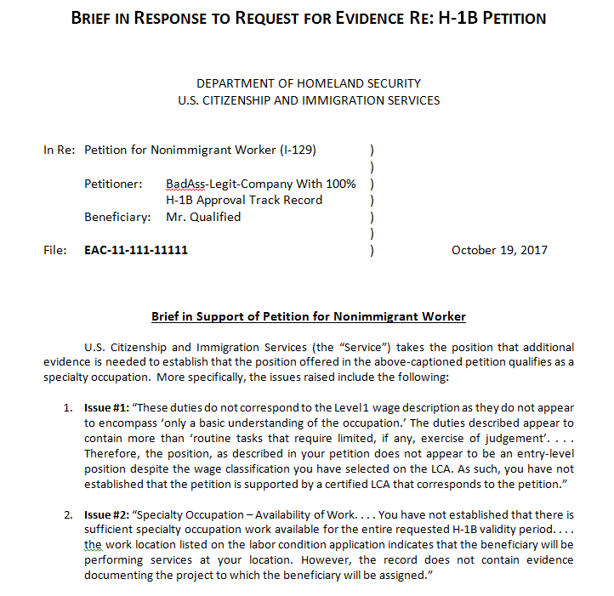
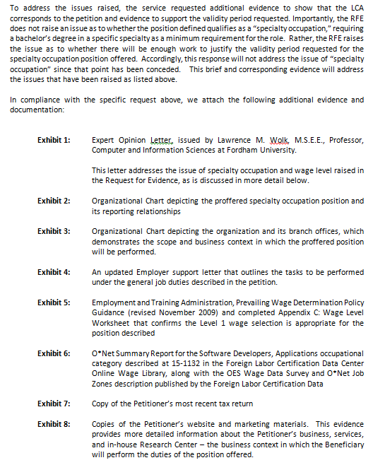
You said you wanted a sample?

Slide 30
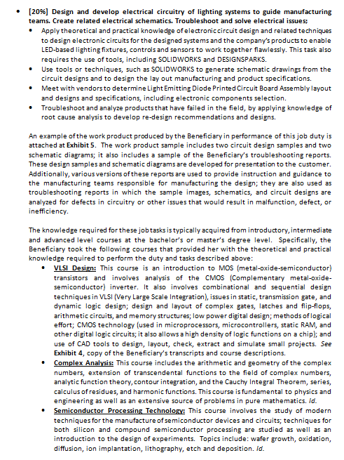
Samples, cont.

Slide 31
Practice considerations
Manage expectations
Inform the client
Examine your pricing structure
Collect additional information upfront and explain why
Prepare your case as if you anticipate litigation

Slide 32
Federal Litigation as an Alternative to Appeal
Are the cases you file bullet-proof? They should be. The landscape for employment-based immigration has changed, and we all need to be ready to change with it, and be willing to fight for our clients.
Why would you sue?
Should you sue?
How you sue in Federal District Court

Slide 33
Why sue instead of filing an appeal?
The abusive tactics in adjudication of cases.
We’ve witnessed a surge of RFEs, NOIR, NOID and denials this past year on clearly meritorious cases.
RFEs/denials in cookie cutter or template formats- did the adjudicator even look at the evidence?
Careless, irrelevant information or requests for evidence, denials that don’t appear to apply to your client.
Incorrect citations.
Backdoor regulating or creating law by RFE/Denials.

Slide 34
Why sue instead of filing an appeal?
Because it just feels good to bring down a bully and do the right thing.
Yes, there are psychological factors in play-it’s empowering to do the right thing, but in addition, we need to send a message that these hostile adjudications will be checked.
Bullies need to be pushed back before they’ll stop. Politely of course.
You have the opportunity to educate the USCIS and judges at the Federal District Court level.

Slide 35
Should You Sue? Factors to consider
That “bullet-proof case” is important (actually, it’s everything) if you sue.
Think of Federal Court as a closed universe.
The only evidence the court can consider is the evidence presented in the initial filing, the response to an RFE or NOIR/NOID. You can’t supplement the record during litigation.
Every case filed should be done so with the above-mentioned in mind. Review your cases filed with the USCIS as if a judge in Fed. Dist. Ct. will be deciding if you have met the burden of proof and the case is clearly approvable.
Is the denial based on a clear error of fact or law?

Slide 36
Factors to consider, cont.
What action is in the client’s best interest?
Consider timing issues
Is refiling an option?
Motion to reopen (new facts)
Motion to reconsider (decision is incorrect based on the applicable law or USCIS policies)
Costs? Litigation is costly, IMHO worth it.
How important is the employee to the company?

Slide 37
Factors to consider, cont. Appeal to AAO?
Why not file an appeal with the Administrative Appeals Office (AAO)?
The Service Center can treat it as a motion; or
Deny again on the same or new grounds; and
The appeal process is slow. Think timing--how would the employee remain in the US with work authorization?

Slide 38
Factors to consider, cont.
Is the company willing to sue?
Again, there are costs to consider.
The company may fear retaliation by the USCIS with regard to future cases.
Do you have the resources within your firm to file suit?
Are you sworn in to practice in the Federal District where the cause of action arose?
Do you understand or are you familiar with the federal rules of evidence/online filing/deadlines/who to sue/where to sue?

Slide 39
A perfect world –a solid case, arbitrary denial and the client wants to sue…
You have a denial and a client ready to fight the denial in Fed. Dist. Ct. What next?
Remember that bullet-proof case?
Did the evidence you provided when you filed meet the preponderance standard?
Preponderance of evidence is the standard of proof in administrative immigration proceedings (unless different standard specified by law).
Have you met the standard of ‘more likely than not’ true based on relevant, probative and credible evidence?
Have you exhausted all relief?
Does it matter that you didn’t file an appeal?
Key: Just because you can doesn’t mean you should. Don’t make bad law by filing suit on a weak case.

Slide 40
How exactly does this work? A simple overview:
How do you sue in Federal Court?
The Administrative Procedures Act (APA)
The APA creates a cause of action/basis to sue the USCIS (any federal agency) when Congress hasn’t provided a separate basis in law.
Your client must have been harmed by the agency action/inaction.
Important: The decision rendered must be “arbitrary, capricious, an abuse of discretion or otherwise not in accordance with law.” 5 USC Sec. 706(2)(A).
The USCIS is required to provide a logical explanation for arriving at their decision, which includes a rational connection between the facts and the decision.
Federal Court Statute of Limitations: General six-year limited. See USC Sec. 2401(a)

Slide 41
Relief
Relief? Under the Administrative Appeals Act you are entitled to non-monetary damages. Reversal of a denial or some other action.
However, you can request attorney’s fees under the Equal Access to Justice Act (EAJA) at 28 U.S. Code Sec. 2412(d).
And, of course, request any and all relief the court deems appropriate.

Slide 42
Relief, damages and reality
Caveat when requesting payment of attorney’s fees under the EAJA.
The EAJA authorizes payment of attorney’s fees to the prevailing party. This means you need a decision rendered by the court, not merely a reversal of the bad decision, in order to be paid pursuant to the EAJA.
Reality – instead of your day in court:
You have the perfect case, you provided ample evidence to meet the preponderance of evidence standard, the denial was arbitrary, against the weight of the evidence, and the company is ready to roll.
You’re sworn in, have mastered the online filing procedures, sued the right parties, your case has been accepted, and is on the desk of an attorney with the Office of Immigration Litigation, somewhere in DC.

Slide 43
Office of Immigration Litigation (OIL), cont.
The OIL attorney has 60 days to respond to your pleadings or file an answer.
You’re ready to argue your case in court.
The phone rings, it’s a (202) number and caller ID shows ‘OIL’ as caller.
This is SO exciting! You have been waiting for this moment for…58 days!
You take the call, have a short discussion of how and why the USCIS is wrong, and the OIL attorney tells you…the decision will be reversed, and an approval granted. Excellent work counselor!
FYI – you aren’t the prevailing party and as such, no EAJA fees.
OR
The USCIS stands by its decision, in which case, the case will proceed, court dates will be set, and onward you go.

Slide 44
Assistance & Resources
AILA: Federal Litigation Section
AILA Link
Litigating Immigration Cases in Federal Court by Robert Pauw (AILA Publications).
American Immigration Council Advisories:
Failure to Appeal to the AAO: Does it Bar All Federal Court Review of the Case? (July 22, 2004)
Immigration Lawsuits and the APA: The Basics of a District Court Action (June 20, 2013).

Slide 45
Assistance & Resources
The American Immigration Council, practice advisories, cont.
Whom to Sue and Whom to Serve in Immigration Related District Court Litigation (May 13, 2010)
Mandamus Actions: Avoiding Dismissal and Proving the Case (August 6, 2009)
Mandamus Jurisdiction over Delayed Applications: Responding to the Government’s Motion to Dismiss (August 30, 2010)
Requesting Attorney’s Fees under the Equal Access to Justice Act (June 17, 2014)
And: The AIC has a business litigation section and may offer guidance on whether your case is meritorious/a winner

Slide 46
Questions?

