Slide 1
Advanced Strategies: Alternatives to the H-1B Work Visa
Brent Huddleston, Haynes & Boone, LLP – Dallas, TX
Dustin O’Quinn, BAL, LLP – Houston, TX

Slide 2
Only a Limited Number of H-1B Visas Available Each Year
65,000 H-1B visa numbers are available per CIS fiscal year, with an additional 20,000 for holders of U.S. advanced degrees
Filing for each fiscal year opens on April 1 of the year prior
Employment for each fiscal year starts on October 1 (so, filing begins 6 months in advance of employment)
Notes:
2

Slide 3
Fiscal Years 2014 and 2015 Caps
Historically, the H-1B caps have been maxed out on the first day of filing. However, this depends on the state of the economy and hiring trends
FY2014 and 2015 caps were reached in the first week of filing
So, there is now a gap until October 2014 where immediate H-1B work authorization is not available
Notes:
3

Slide 4
Before October 1st:
If F-1 student has OPT that expires before October 1, the F-1 should receive an automatic extension of work authorization if the H-1B case is accepted for processing (automatic extension will be valid until October 1)
Sometimes, even if the foreign national has been approved for H-1B, there may be a gap in status and/or employment authorization before the H-1B start date
Consider risks and opportunities of international travel before October 1
Consider other visa categories
Communication between employer and employee is key
Notes:
4

Slide 5
NIV Alternatives to H-1Bs
OPT extension for STEM grads/E-Verify
H-3 for Trainees
Country specific visas (H-1B1, E-3, TN)
L-1 for Intracompany Transferees
O-1 for Extraordinary Ability
E-2 for Investors or Essential Employees

Slide 6
F-1 Student with Employment Authorization
Student can engage in Optional or Curricular Practical Training (OPT or CPT)
CPT occurs while still in school – work is authorized by the school on I-20
OPT occurs upon graduation – requires a USCIS-issued EAD
OPT can be extended for an additional 17 months for graduates with degree in STEM field

Slide 7
H-3 Trainee
The specific training must be unavailable in the beneficiary’s home country
The purpose of U.S. training should be to prepare the Trainee for a career abroad
Any productive employment must be incidental to the training
Valid for up to 2 years maximum
Notes:
7

Slide 8
H-1B1 Chile, Singapore
The numbers set aside are a subset of the overall H-1B cap
The beneficiary must be citizen of Chile or Singapore
Basic requirements are the same as for any H-1B
Visas numbers usually remain available throughout fiscal year
Valid in one-year increments
A change to a three-year H-1B in a subsequent fiscal year will require a new H-1B fee and a new H-1B number from that future year’s H-1B cap
Notes:
8

Slide 9
E-3 Treaty Visa for Australians
E-3 Visa Program for Australian Nationals as alternative to H-1B
Australian professionals working in specialty occupations are granted an anticipated 10,500 visa numbers per fiscal year
Spouses may apply for employment authorization
Apply directly at U.S. Consulate (no CIS delays)
Notes:
9

Slide 10
TN Trade NAFTA
The beneficiary must be citizen of Canada or Mexico
The position must fit into one of the 60+ professional occupation categories enumerated in NAFTA
The beneficiary must have the specific credentials listed for that occupation (generally equivalencies are not acceptable)
Valid for only 1-3 years per issuance, but can be renewed indefinitely (although with practical limitations)
Application directly at the Port of Entry (for Canadians) or at the Consulate (for Mexicans) avoids CIS delays
Notes:
10

Slide 11
L-1 Intracompany Transferee
Must have worked abroad for parent, subsidiary, affiliate, or branch for one continuous year out of the three years immediately preceding entry to the U.S.
NOTE: The candidate need not be presently employed with a related entity abroad
Maximum time for executive or manager is 7 years
Maximum time for specialized knowledge professional is 5 years
Time in L-1 status counts toward the 6-year H-1B maximum
Spouses of L-1 workers can obtain work authorization in the U.S.
Notes:
11

Slide 12
O-1 “Alien of Extraordinary Ability”
Used by Artists, Scientists, Innovators, Athletes, Specialists
Must be able to prove person is one of the very few that have risen to the top of his/her field of endeavor
Normally requires proof of national/international awards, publications, patents, public recognition of expertise
No maximum limitation of stay
Notes:
12

Slide 13
E-1 Treaty Traders & E-2 Treaty Investors
The sponsoring entity must be at least 51% foreign- owned by a company or individual with the citizenship of the treaty country
An appropriate treaty between the U.S. and the foreign country of origin must be in place
The foreign national employee must share the same citizenship as the company
The position must be managerial in nature or one requiring “essential skills” or specialized experience
Notes:
13

Slide 14
Taking an Assignment Abroad
Many international companies have started sending foreign employees to offices abroad for experience while they wait out the H-1B lottery
Especially valuable for those subject to the J-1 2-year home-residence requirement
If assignment abroad is at least 1-year in length, then L-1 option may also be available
Notes:
14

Slide 15
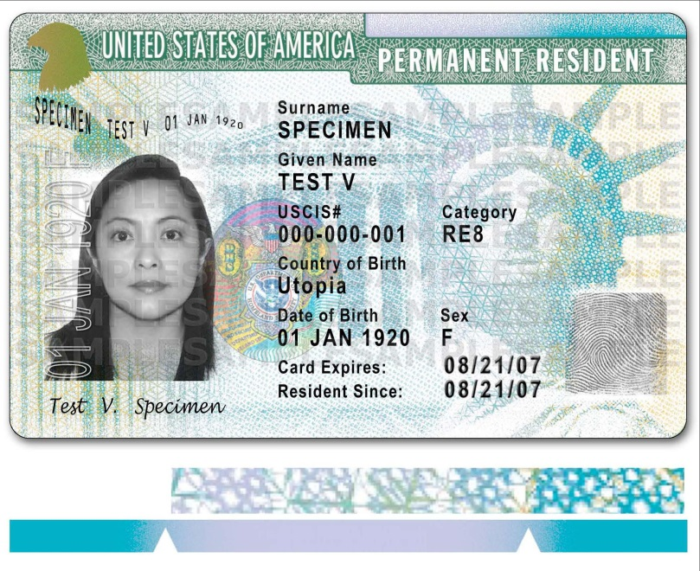
Immigrant Petition
Depending on the circumstances, it may be viable to go straight from OPT to permanent residence
In some cases, concurrent filing of I-140 & I-485 is possible, which allows the applicant to also apply for an Employment Authorization Card as an “intending immigrant”
Family-based immigration is also an option for Immediate Relatives of U.S. Citizens
Notes:
15

Slide 16
Questions?

